Slide 1
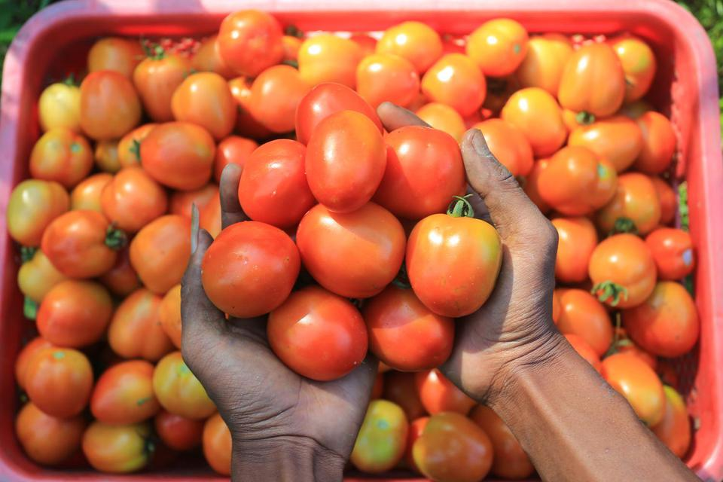


Universitas Brawijaya
PRESENTASI
HASIL SKRIPSI
Abdi Negara Guci
( 205090401111033 )

Slide 2


Universitas Brawijaya
PEMBAHASAN
Latar Belakang
Landasan Teori
Rumusan Masalah
Metode Penelitian
Tujuan Penelitian
Hasil dan Pembahasan

Slide 3
Universitas Brawijaya
Latar Belakang

Slide 4
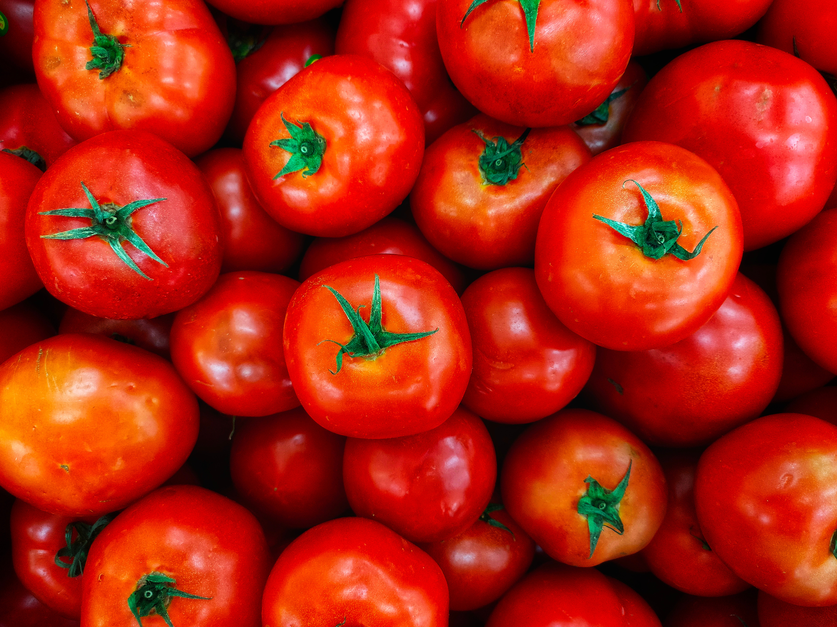
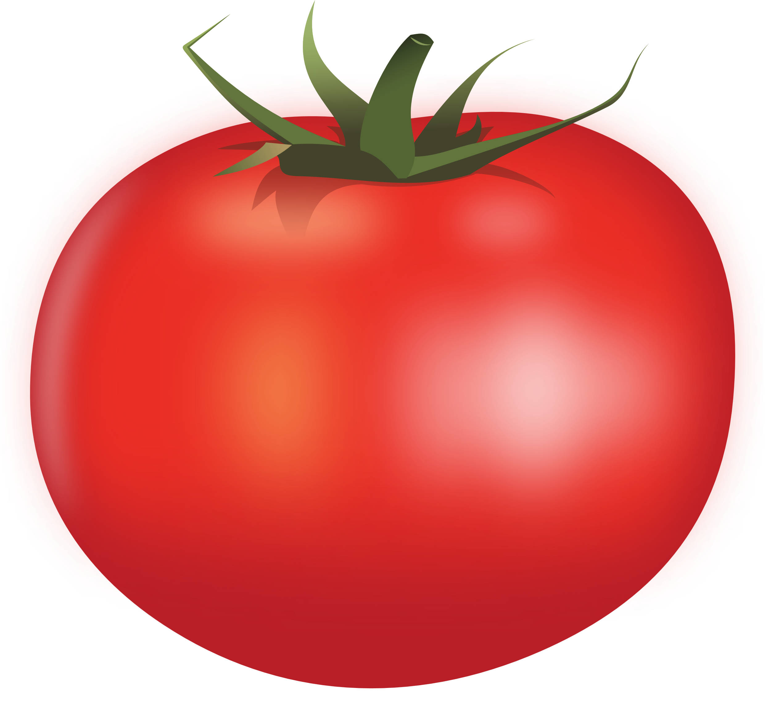
Universitas Brawijaya
LATAR BELAKANG
Buah Tomat

Slide 5
LATAR BELAKANG
Universitas Brawijaya
nilai ekonomi tinggi
Buah Tomat
Produksi yang sangat tinggi
baik untuk sesehatan

Slide 6

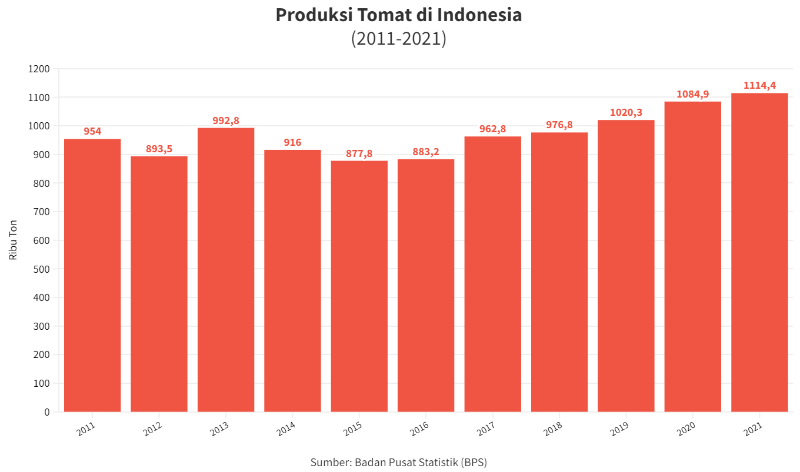
Universitas Brawijaya

Slide 7
Universitas Brawijaya
Peningkatan Produksi Tomat Terus Meningkat 5-6 tahun terakhir
Linear

Slide 8
Universitas Brawijaya
LATAR BELAKANG
Buah Tomat

Slide 9
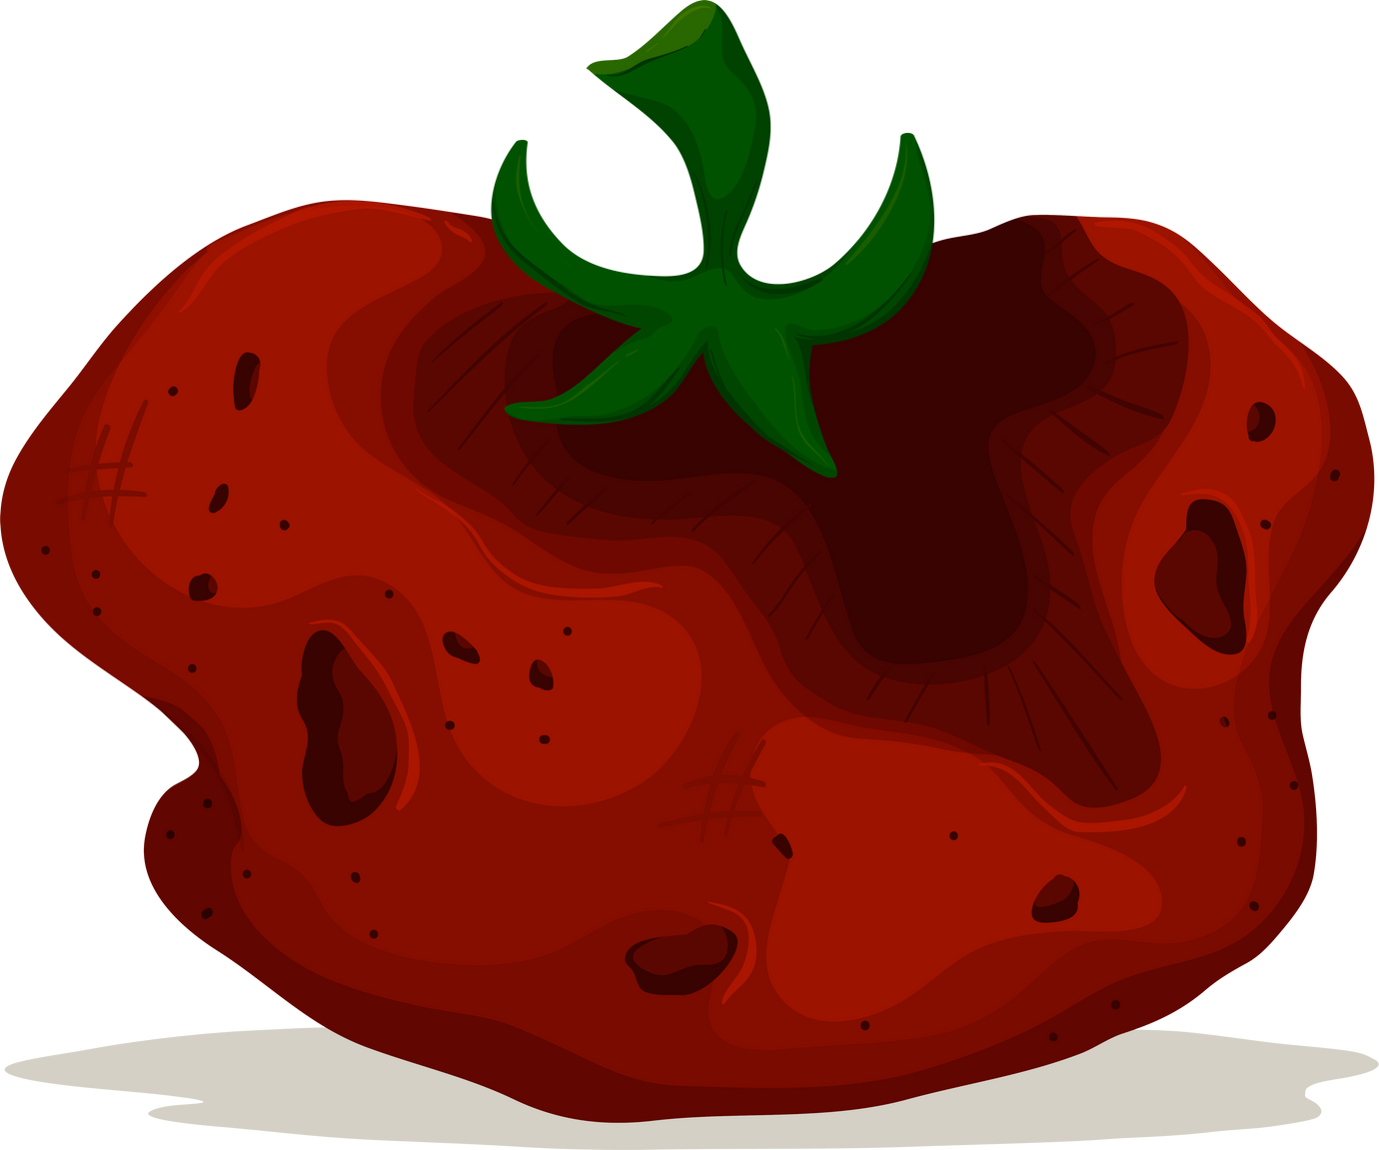
Universitas Brawijaya
LATAR BELAKANG
Tomat BUsuk

Slide 10
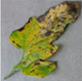
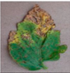
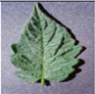
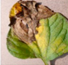
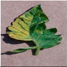
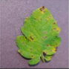
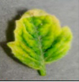
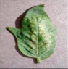
LATAR BELAKANG
Universitas Brawijaya

Slide 11

LATAR BELAKANG
Universitas Brawijaya
Otomatis
Bacterial Spot

Slide 12

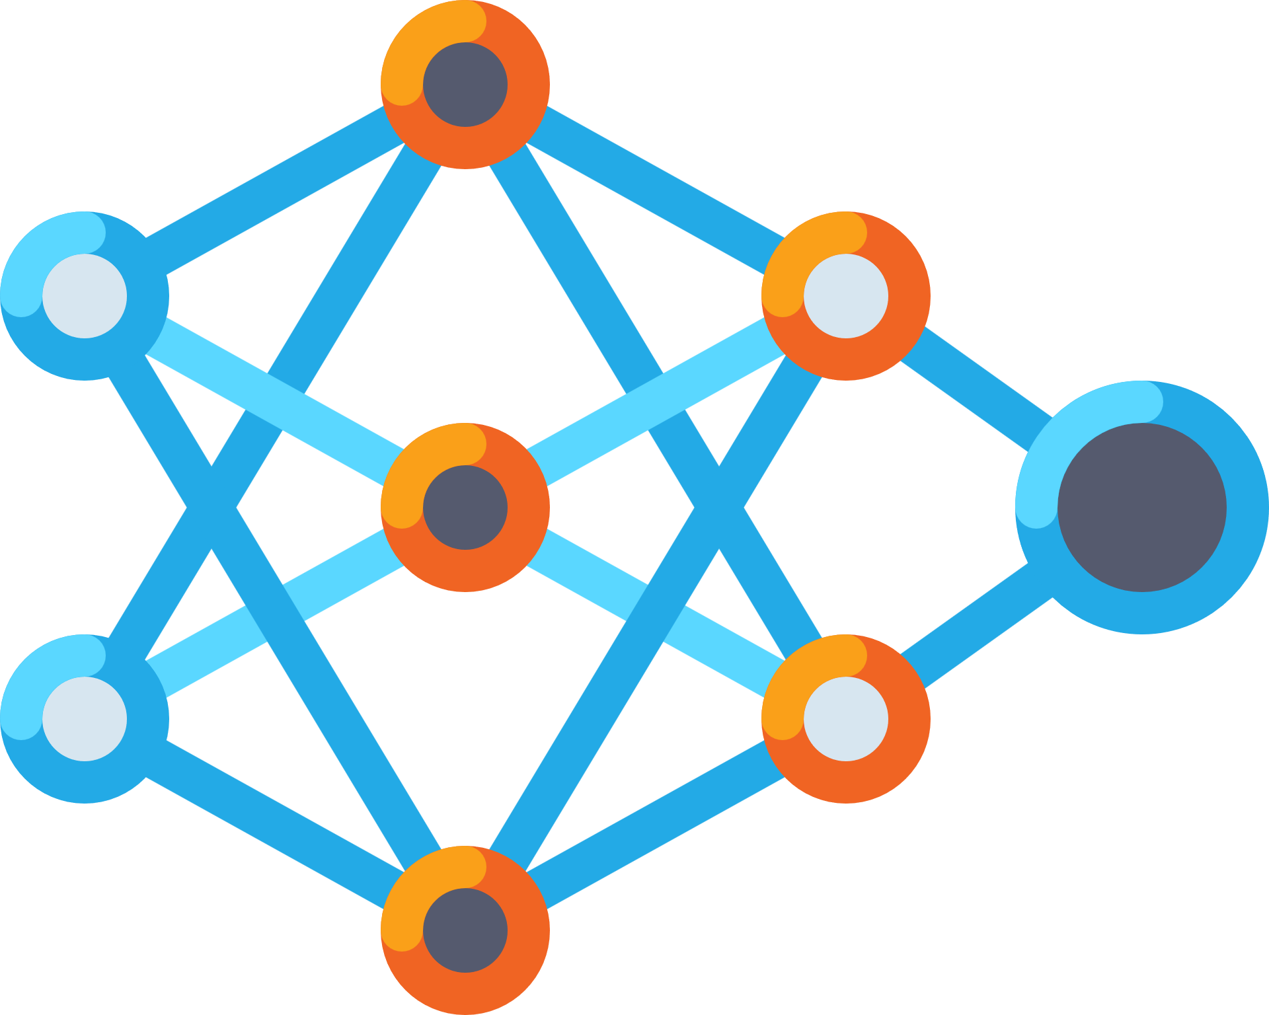
LATAR BELAKANG
Universitas Brawijaya
Machine Learning
Bacterial Spot

Slide 13
LATAR BELAKANG
Universitas Brawijaya
Keunggulan
Machine Learning
Bacterial Spot
pengambilan keputusan yang cepat,
meminimalkan biaya,
minim human error
dapat terus beradaptasi untuk meningkatkan kinerjanya.

Slide 14
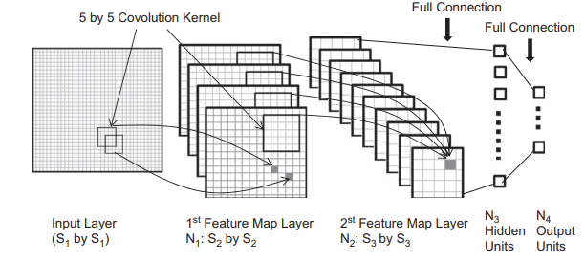
LATAR BELAKANG
Universitas Brawijaya
Convolutional Neural Network

Slide 15
LATAR BELAKANG
Universitas Brawijaya
Convolutional Neural Network
Keunggulan
Kelebihan
Dapat Mengatasi Data yang Besar
Feature Ekstaksi Secara Otomatis
Mampu digunakan dalam Citra Digital

Slide 16
LATAR BELAKANG
Universitas Brawijaya
Convolutional Neural Network
Keunggulan
Kelebihan
Dapat Mengatasi Data yang Besar
Feature Ekstaksi Secara Otomatis
Mampu digunakan dalam Citra Digital
Kelemahan
Waktu Komputasi yang Cukup Lama
KekuranganN

Slide 17
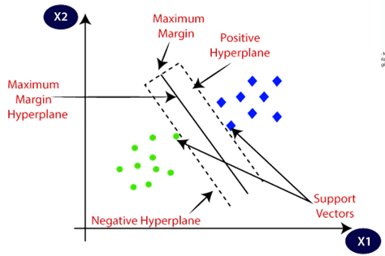
LATAR BELAKANG
Universitas Brawijaya
Convolutional Neural Network
Keunggulan
Kelebihan
Support Vektor Machine
Dapat Mengatasi Data yang Besar
Feature Ekstaksi Secara Otomatis
Mampu digunakan dalam Citra Digital
Kelemahan
Kekurangan
Waktu Komputasi yang Cukup Lama

Slide 18
LATAR BELAKANG
Universitas Brawijaya
Convolutional Neural Network
Support Vektor Machine
Keunggulan
Keunggulan
Kelebihan
Kelebihan
Dapat Mengatasi Data yang Besar
Waktu Computasi Yang Cukup Cepat
Feature Ekstaksi Secara Otomatis
Mengatasi Masalah Yang tinggi
Mampu digunakan dalam Citra Digital
Kelemahan
Kekurangan
Waktu Komputasi yang Cukup Lama

Slide 19
LATAR BELAKANG
Universitas Brawijaya
+
Convolutional Neural Network
Support Vektor Machine
Keunggulan
Keunggulan
Kelebihan
Kelebihan
Dapat Mengatasi Data yang Besar
Waktu Computasi Yang Cukup Cepat
Feature Ekstaksi Secara Otomatis
Mengatasi Masalah Yang tinggi
Mampu digunakan dalam Citra Digital
Kelemahan
Kekurangan
Waktu Komputasi yang Cukup Lama

Slide 20
LATAR BELAKANG
Universitas Brawijaya
hybrid CNN-SVM
Keunggulan
Kelebihan
Dapat Mengatasi Data yang Besar
Feature Ekstaksi Secara Otomatis
Mampu digunakan dalam Citra Digital
Waktu Komputasi yang Cukup Lama
Pertanyaan?
Bagaimana Cara Menggabungkan 2 metode ini?

Slide 21
LATAR BELAKANG
Universitas Brawijaya
Convolutional Neural Network

Slide 22
LATAR BELAKANG
Universitas Brawijaya
Hybrid CNN-SVM
Mengubah Output Fully Connected Layer

Slide 23
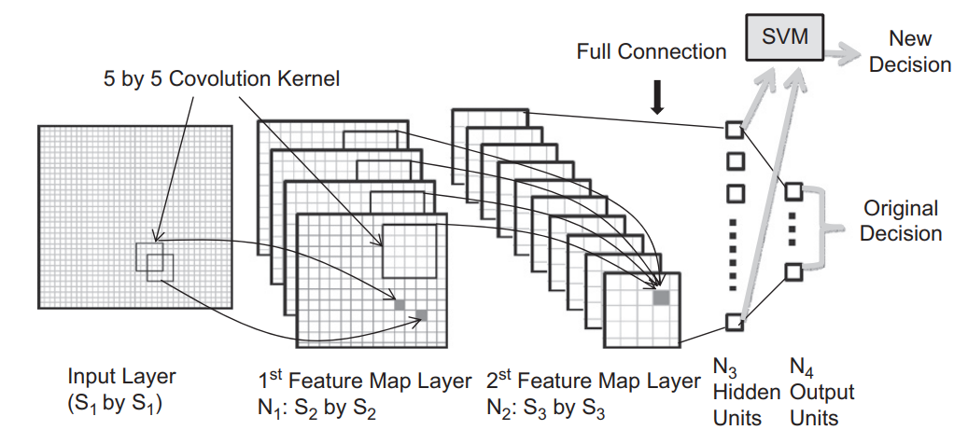
LATAR BELAKANG
Universitas Brawijaya
Hybrid CNN-SVM
Mengubah Output Fully Connected Layer

Slide 24
Universitas Brawijaya
JUDUL
PENGEMBANGAN MODEL KLASIFIKASI PENYAKIT DAUN TOMAT MENGGUNAKAN HYBRID CNN-SVM CLASSIFIER

Slide 25
Universitas Brawijaya
Rumusan Masalah

Slide 26
Universitas Brawijaya
RUMUSAN MASALAH
1
2
Bagaimana mengkombinasikan metode CNN dan SVM untuk mengklasifikasikan penyakit daun tomat?
Bagaimana performa metode hybrid CNN-SVM dalam mengklasifikasikan penyakit pada daun tomat?

Slide 27
Universitas Brawijaya
Tujuan Penelitian

Slide 28


Universitas Ginyard
TUJUAN PENELITIAN
Menganalisis hasil evaluasi dari metode CNN-SVM.
Menganalisis perbandingan hasil evaluasi metode CNN-SVM dengan pretrained model CNN dalam mengklasifikasikan penyakit pada daun tomat.

Slide 29
Universitas Brawijaya
Landasan Teori

Slide 30
LANDASAN TEORI
Universitas Brawijaya
3 pertanyaan Dasar
Apa object pada penelitian ini?
Apa metode utama yang digunakan?
apa saja metode pendukung yang di gunakan?

Slide 31
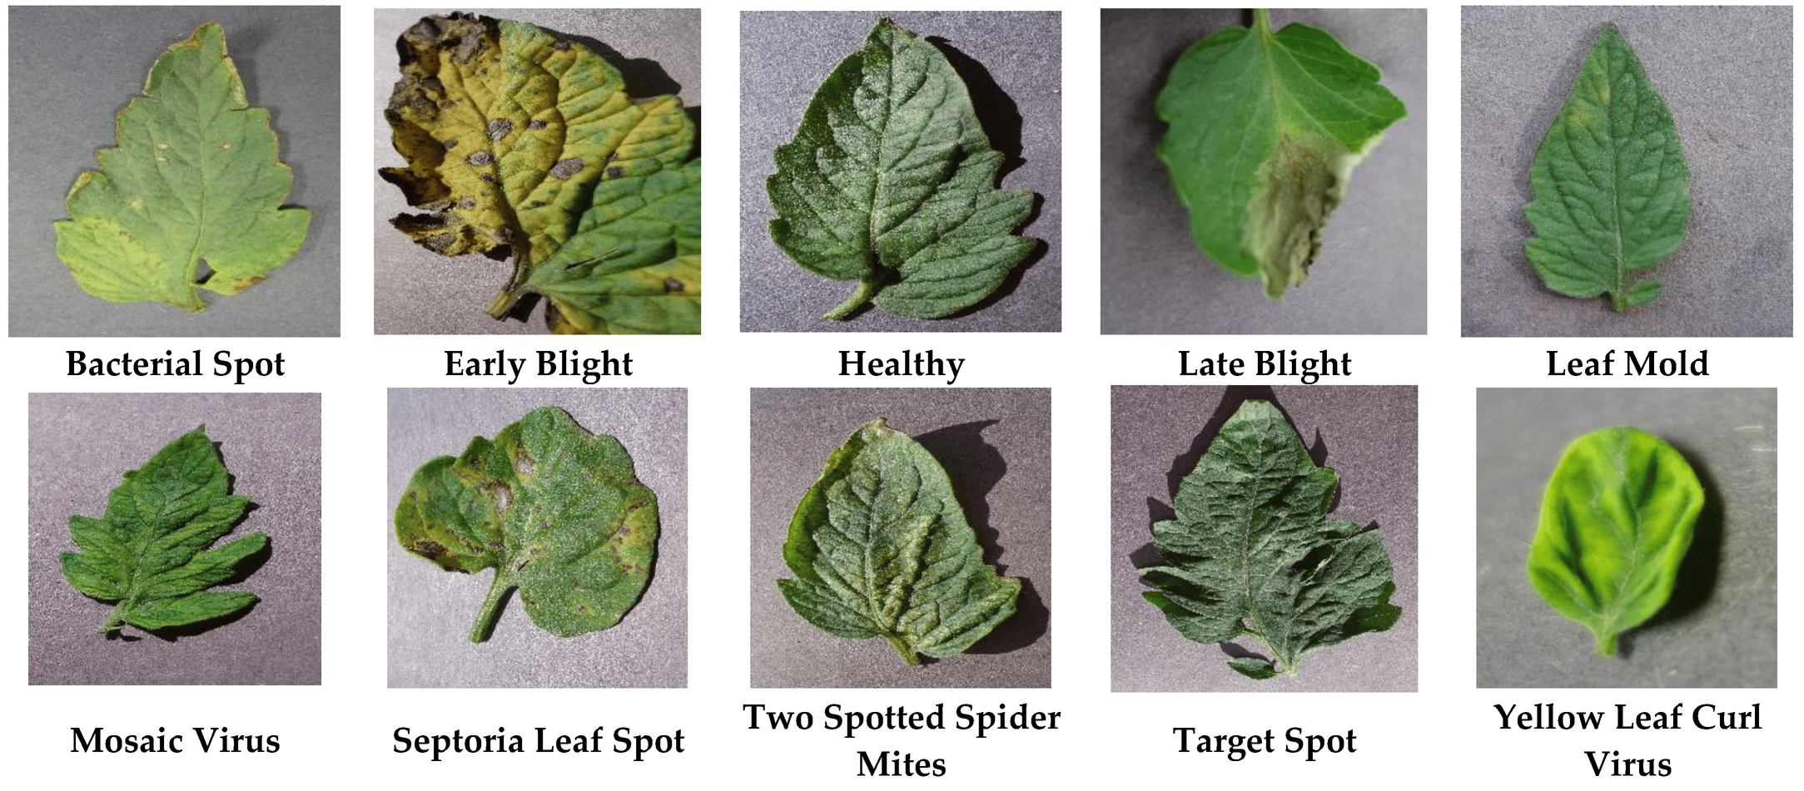
LANDASAN TEORI
Universitas Brawijaya
Penyakit Daun Tomat

Slide 32
LANDASAN TEORI
Universitas Brawijaya
Penyakit Daun Tomat
Setiap jenis penyakit pada daun disebabkan oleh faktor yang berbeda beda

Slide 33
LANDASAN TEORI
Universitas Brawijaya
3 pertanyaan Dasar
✓
Apa object pada penelitian ini?
Apa Tinjauan utama yang digunakan?
apa saja Tinjauan pendukung yang di gunakan?

Slide 34
LANDASAN TEORI
Universitas Brawijaya
Convolutional Neural Network

Slide 35

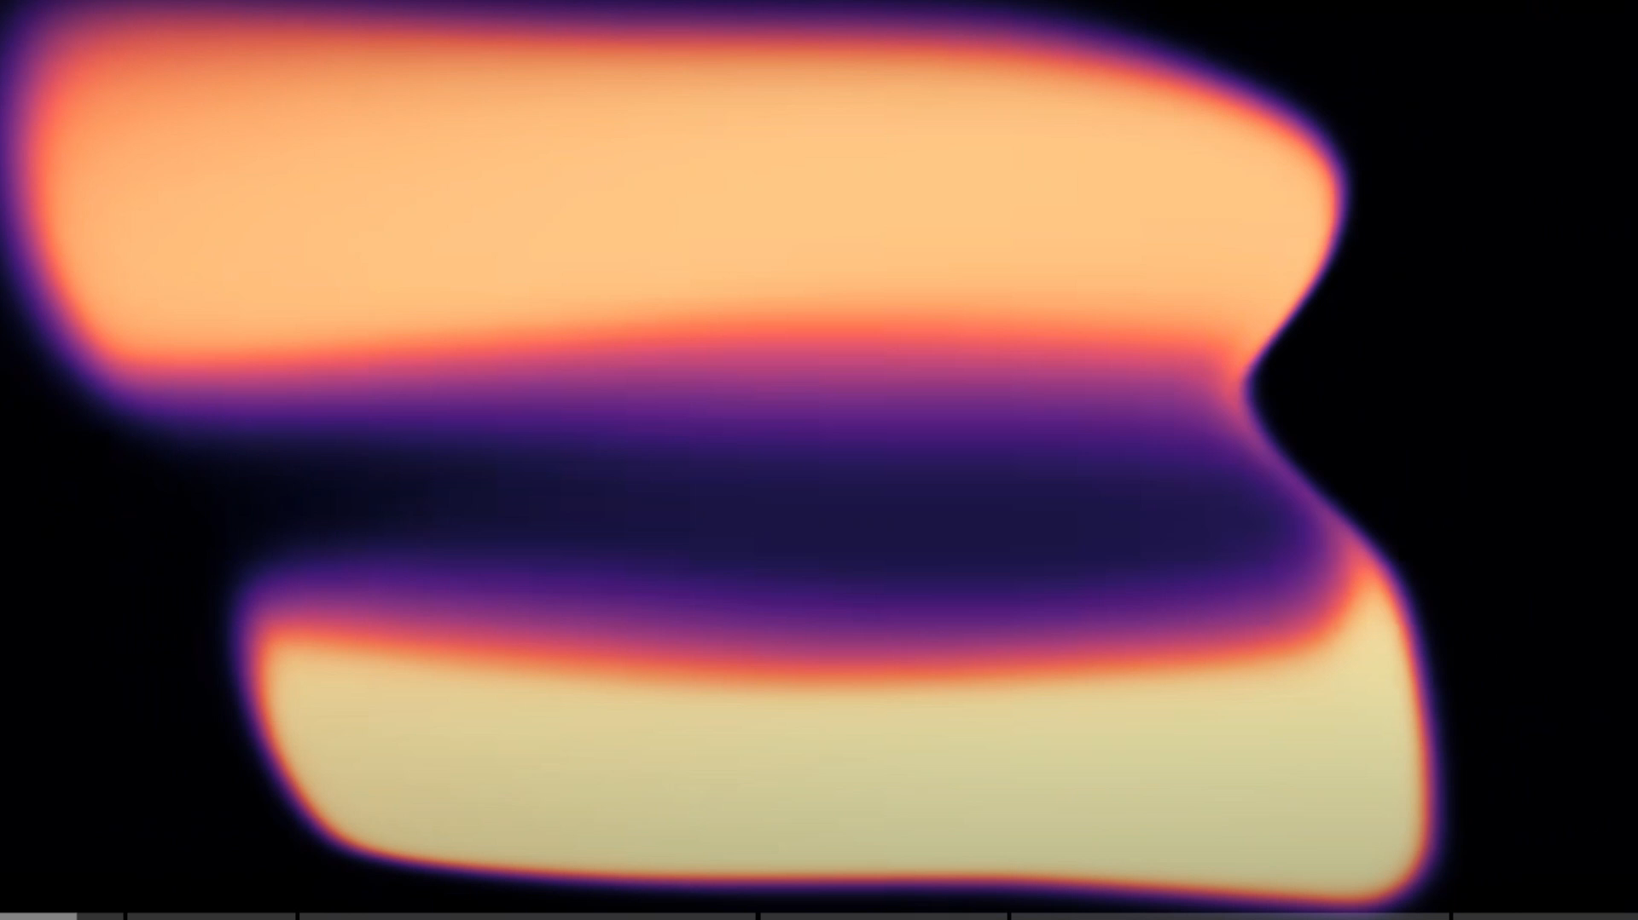
$$Why neural network is a powerfull method for image classification?$$
$$Feature extraction of hello world image$$

Slide 36
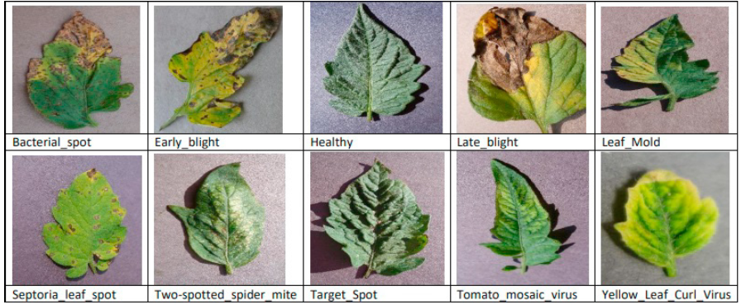
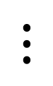
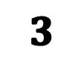
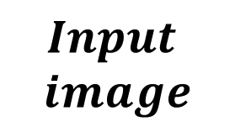
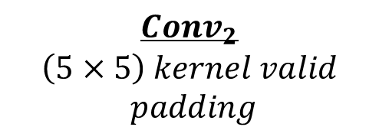


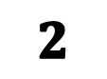
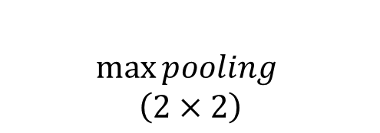


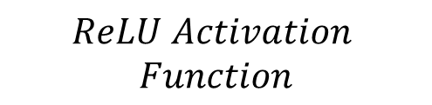
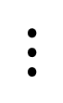
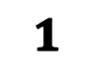
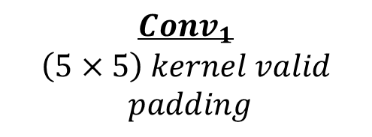

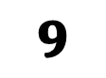

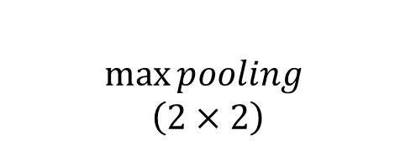



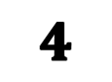

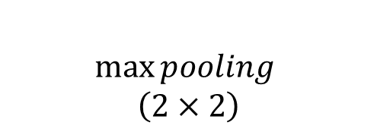
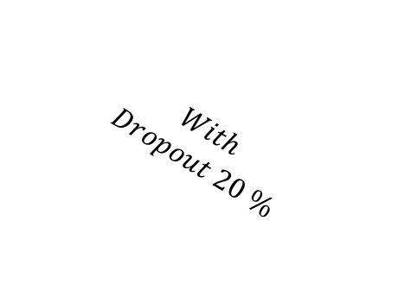
$$ReLU Activation$$
$$Function$$
$$Conv_{1}$$
$$\left(5×5\right) kernel valid$$
$$padding$$
$$\max{pooling }$$
$$\left(2×2\right)$$
$$Conv_{2}$$
$$\left(5×5\right) kernel valid$$
$$padding$$
$$\max{pooling }$$
$$\left(2×2\right)$$
$$\max{pooling }$$
$$\left(2×2\right)$$
$$Flatten$$
$$Layer$$
$$With$$
$$Dropout 20 \%$$
$$Input$$
$$image$$
$$Convolutional Layer$$
$$Convolutional Layer$$
$$1$$
$$2$$
$$3$$
$$4$$
$$Pooling Layer$$
$$Pooling Layer$$
$$⋮$$
$$input$$
$$28×28×1$$
$$n_{1} Channel$$
$$24×24×n_{1}$$
$$n_{1} Channel$$
$$12×12×n_{1}$$
$$n_{2} Channel$$
$$8×8×n_{2}$$
$$n_{2} Channel$$
$$4×4×n_{2}$$
$$⋮$$
$$9$$
$$⋮$$
$$Output$$
$$fully connected$$
$$Layer$$

Slide 37
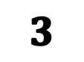
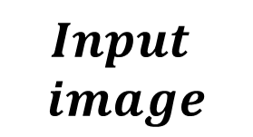


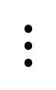
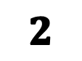
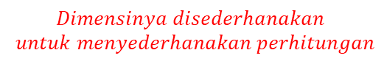

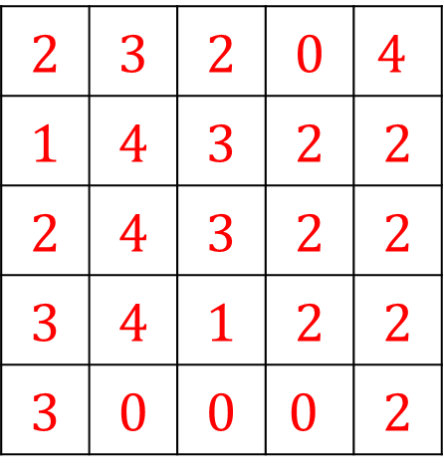
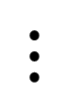
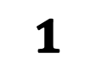
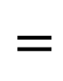
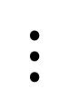
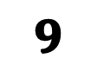





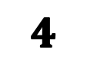

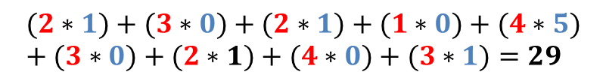
$$Flatten$$
$$Layer$$
$$Input$$
$$image$$
$$Convolutional Layer$$
$$Convolutional Layer$$
$$1$$
$$2$$
$$3$$
$$4$$
$$input$$
$$28×28×1$$
$$Pooling Layer$$
$$Pooling Layer$$
$$⋮$$
$$Dimensinya disederhanakan$$
$$untuk menyederhanakan perhitungan$$
$$⋮$$
$$9$$
$$input\left(X\right)$$
$$5×5×1$$
$$⋮$$
$$(2∗1)+(3∗0)+(2∗1)+(1∗0)+(4∗5)+(3∗0)+(2∗1)+(4∗0)+(3∗1)=29$$
$$Output$$
$$Kernel \left(K\right)$$
$$3×3×1$$
$$Filter \left(F\right)$$
$$3×3×1$$
2 | 3 | 2 | 0 | $$4$$
1 | 4 | 3 | 2 | 2
2 | 4 | 3 | 2 | 2
3 | 4 | 1 | 2 | 2
3 | 0 | 0 | $$0$$ | 2
1 | 0 | 1
0 | 5 | 0
1 | 0 | 1
29
$$∗$$
$$=$$
$$fully connected$$
$$Layer$$

Slide 38
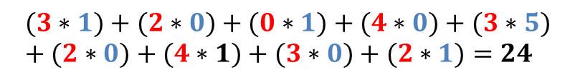
$$Flatten$$
$$Layer$$
$$Input$$
$$image$$
$$Convolutional Layer$$
$$Convolutional Layer$$
$$1$$
$$2$$
$$3$$
$$4$$
$$input$$
$$28×28×1$$
$$Pooling Layer$$
$$Pooling Layer$$
$$⋮$$
$$Dimensinya disederhanakan$$
$$untuk menyederhanakan perhitungan$$
$$⋮$$
$$9$$
$$input\left(X\right)$$
$$5×5×1$$
$$⋮$$
$$(2∗1)+(3∗0)+(2∗1)+(1∗0)+(4∗5)+(3∗0)+(2∗1)+(4∗0)+(3∗1)=29$$
$$Output$$
$$Kernel \left(K\right)$$
$$3×3×1$$
$$Filter \left(F\right)$$
$$3×3×1$$
2 | 3 | 2 | 0 | $$4$$
1 | 4 | 3 | 2 | 2
2 | 4 | 3 | 2 | 2
3 | 4 | 1 | 2 | 2
3 | 0 | 0 | $$0$$ | 2
29 | 24
$$(3∗1)+(2∗0)+(0∗1)+(4∗0)+(3∗5)+(2∗0)+(4∗1)+(3∗0)+(2∗1)=24$$
1 | 0 | 1
0 | 5 | 0
1 | 0 | 1
$$∗$$
$$=$$
$$fully connected$$
$$Layer$$

Slide 39
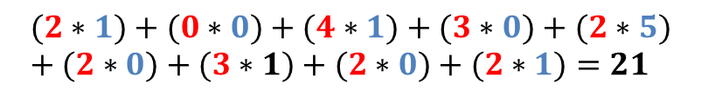

$$Flatten$$
$$Layer$$
$$Input$$
$$image$$
$$Convolutional Layer$$
$$Convolutional Layer$$
$$1$$
$$2$$
$$3$$
$$4$$
$$input$$
$$28×28×1$$
$$Pooling Layer$$
$$Pooling Layer$$
$$⋮$$
$$Dimensinya disederhanakan$$
$$untuk menyederhanakan perhitungan$$
$$⋮$$
$$9$$
$$input\left(X\right)$$
$$5×5×1$$
$$⋮$$
$$(2∗1)+(3∗0)+(2∗1)+(1∗0)+(4∗5)+(3∗0)+(2∗1)+(4∗0)+(3∗1)=29$$
$$Output$$
$$Kernel \left(K\right)$$
$$3×3×1$$
$$Filter \left(F\right)$$
$$3×3×1$$
2 | 3 | 2 | 0 | $$4$$
1 | 4 | 3 | 2 | 2
2 | 4 | 3 | 2 | 2
3 | 4 | 1 | 2 | 2
3 | 0 | 0 | $$0$$ | 2
29 | 24 | 21
$$(3∗1)+(2∗0)+(0∗1)+(4∗0)+(3∗5)+(2∗0)+(4∗1)+(3∗0)+(2∗1)=24$$
1 | 0 | 1
0 | 5 | 0
1 | 0 | 1
$$∗$$
$$=$$
$$fully connected$$
$$Layer$$
$$(2∗1)+(0∗0)+(4∗1)+(3∗0)+(2∗5)+(2∗0)+(3∗1)+(2∗0)+(2∗1)=21$$

Slide 40


$$Flatten$$
$$Layer$$
$$Input$$
$$image$$
$$Convolutional Layer$$
$$Convolutional Layer$$
$$1$$
$$2$$
$$3$$
$$4$$
$$input$$
$$28×28×1$$
$$Pooling Layer$$
$$Pooling Layer$$
$$⋮$$
$$Dimensinya disederhanakan$$
$$untuk menyederhanakan perhitungan$$
$$⋮$$
$$9$$
$$input\left(X\right)$$
$$5×5×1$$
$$⋮$$
$$(2∗1)+(3∗0)+(2∗1)+(1∗0)+(4∗5)+(3∗0)+(2∗1)+(4∗0)+(3∗1)=29$$
$$Output$$
$$Kernel \left(K\right)$$
$$3×3×1$$
$$Filter \left(F\right)$$
$$3×3×1$$
2 | 3 | 2 | 0 | $$4$$
1 | 4 | 3 | 2 | 2
2 | 4 | 3 | 2 | 2
3 | 4 | 1 | 2 | 2
3 | 0 | 0 | $$0$$ | 2
29 | 24 | 21
28 | 27 | 18
28 | 11 | 17
$$(3∗1)+(2∗0)+(0∗1)+(4∗0)+(3∗5)+(2∗0)+(4∗1)+(3∗0)+(2∗1)=24$$
1 | 0 | 1
0 | 5 | 0
1 | 0 | 1
$$∗$$
$$=$$
$$fully connected$$
$$Layer$$
$$(2∗1)+(0∗0)+(4∗1)+(3∗0)+(2∗5)+(2∗0)+(3∗1)+(2∗0)+(2∗1)=21$$
$$⋮$$
$$(3∗1)+(2∗0)+(2∗1)+(1∗0)+(2∗5)+(2∗0)+(0∗1)+(0∗0)+(2∗1)=17$$

Slide 41



$$Flatten$$
$$Layer$$
$$Input$$
$$image$$
$$Convolutional Layer$$
$$Convolutional Layer$$
$$1$$
$$2$$
$$3$$
$$4$$
$$input$$
$$28×28×1$$
$$Pooling Layer$$
$$Pooling Layer$$
$$⋮$$
$$Dimensinya disederhanakan$$
$$untuk menyederhanakan perhitungan$$
$$⋮$$
$$9$$
$$input\left(X\right)$$
$$5×5×1$$
$$⋮$$
$$(2∗1)+(3∗0)+(2∗1)+(1∗0)+(4∗5)+(3∗0)+(2∗1)+(4∗0)+(3∗1)=29$$
$$Output$$
$$Kernel \left(K\right)$$
$$3×3×1$$
$$Filter \left(F\right)$$
$$3×3×1$$
2 | 3 | 2 | 0 | $$4$$
1 | 4 | 3 | 2 | 2
2 | 4 | 3 | 2 | 2
3 | 4 | 1 | 2 | 2
3 | 0 | 0 | $$0$$ | 2
29 | 24 | 21
28 | 27 | 18
28 | 11 | 17
$$(3∗1)+(2∗0)+(0∗1)+(4∗0)+(3∗5)+(2∗0)+(4∗1)+(3∗0)+(2∗1)=24$$
1 | 0 | 1
0 | 5 | 0
1 | 0 | 1
$$∗$$
$$=$$
$$fully connected$$
$$Layer$$
$$(2∗1)+(0∗0)+(4∗1)+(3∗0)+(2∗5)+(2∗0)+(3∗1)+(2∗0)+(2∗1)=21$$
$$⋮$$
$$(3∗1)+(2∗0)+(2∗1)+(1∗0)+(2∗5)+(2∗0)+(0∗1)+(0∗0)+(2∗1)=17$$
$$Stride\left(S\right) =1$$
$$Padding(P)=0$$
$$dim\left(f\right)=\left(\dim\left(X\right)−\dim\left(K\right)+2P\right)S+1$$
$$=3$$
$$Rumus Konvolusi$$
$$F\left(i,j\right)=\sum_{p=0}^{k_{m}−1}{\sum_{q=0}^{k_{n}−1}{X\left(i+p,j+q\right)∗K\left(q , p\right)}}.$$

Slide 42








$$Conv_{1}$$
$$\left(5×5\right) kernel valid$$
$$padding$$
$$\max{pooling }$$
$$\left(2×2\right)$$
$$Flatten$$
$$Layer$$
$$Input$$
$$image$$
$$Convolutional Layer$$
$$Convolutional Layer$$
$$1$$
$$2$$
$$3$$
$$4$$
$$Pooling Layer$$
$$Pooling Layer$$
$$⋮$$
$$input$$
$$28×28×1$$
$$n_{1} Channel$$
$$24×24×n_{1}$$
$$n_{1} Channel$$
$$12×12×n_{1}$$
$$⋮$$
$$⋮$$
$$9$$
Tujuan :untuk mengurangi dimensi dari feature yang dihasilkan oleh lapisan konvolusi dalam CNN, sambil mempertahankan informasi yang paling penting
$$Output$$
$$Feature map(F)$$
$$3×3×n_{1}$$
$$Pooling Layer\left(θ\right)$$
$$2×2×n_{1}$$
29 | 24 | 21
28 | 27 | 18
28 | 11 | 17
29
$$fully connected$$
$$Layer$$
$$=$$

Slide 43
$$Conv_{1}$$
$$\left(5×5\right) kernel valid$$
$$padding$$
$$\max{pooling }$$
$$\left(2×2\right)$$
$$Flatten$$
$$Layer$$
$$Input$$
$$image$$
$$Convolutional Layer$$
$$Convolutional Layer$$
$$1$$
$$2$$
$$3$$
$$4$$
$$Pooling Layer$$
$$Pooling Layer$$
$$⋮$$
$$input$$
$$28×28×1$$
$$n_{1} Channel$$
$$24×24×n_{1}$$
$$n_{1} Channel$$
$$12×12×n_{1}$$
$$⋮$$
$$⋮$$
$$9$$
Tujuan :untuk mengurangi dimensi dari feature yang dihasilkan oleh lapisan konvolusi dalam CNN, sambil mempertahankan informasi yang paling penting
$$Output$$
$$Feature map(F)$$
$$3×3×n_{1}$$
$$Pooling Layer\left(θ\right)$$
$$2×2×n_{1}$$
29 | 24 | 21
28 | 27 | 18
28 | 11 | 17
29 | 27
$$fully connected$$
$$Layer$$
$$=$$

Slide 44

$$Conv_{1}$$
$$\left(5×5\right) kernel valid$$
$$padding$$
$$\max{pooling }$$
$$\left(2×2\right)$$
$$Flatten$$
$$Layer$$
$$Input$$
$$image$$
$$Convolutional Layer$$
$$Convolutional Layer$$
$$1$$
$$2$$
$$3$$
$$4$$
$$Pooling Layer$$
$$Pooling Layer$$
$$⋮$$
$$input$$
$$28×28×1$$
$$n_{1} Channel$$
$$24×24×n_{1}$$
$$n_{1} Channel$$
$$12×12×n_{1}$$
$$⋮$$
$$⋮$$
$$9$$
Tujuan :untuk mengurangi dimensi dari feature yang dihasilkan oleh lapisan konvolusi dalam CNN, sambil mempertahankan informasi yang paling penting
$$Output$$
$$Feature map(F)$$
$$3×3×n_{1}$$
$$Pooling Layer\left(θ\right)$$
$$2×2×n_{1}$$
29 | 24 | 21
28 | 27 | 18
28 | 11 | 17
29 | 27
28
$$fully connected$$
$$Layer$$
$$=$$

Slide 45
$$Conv_{1}$$
$$\left(5×5\right) kernel valid$$
$$padding$$
$$\max{pooling }$$
$$\left(2×2\right)$$
$$Flatten$$
$$Layer$$
$$Input$$
$$image$$
$$Convolutional Layer$$
$$Convolutional Layer$$
$$1$$
$$2$$
$$3$$
$$4$$
$$Pooling Layer$$
$$Pooling Layer$$
$$⋮$$
$$input$$
$$28×28×1$$
$$n_{1} Channel$$
$$24×24×n_{1}$$
$$n_{1} Channel$$
$$12×12×n_{1}$$
$$⋮$$
$$⋮$$
$$9$$
Tujuan :untuk mengurangi dimensi dari feature yang dihasilkan oleh lapisan konvolusi dalam CNN, sambil mempertahankan informasi yang paling penting
$$Output$$
$$Feature map(F)$$
$$3×3×n_{1}$$
$$Pooling Layer\left(θ\right)$$
$$2×2×n_{1}$$
29 | 24 | 21
28 | 27 | 18
28 | 11 | 17
29 | 27
28 | 27
$$fully connected$$
$$Layer$$
$$=$$

Slide 46


$$Conv_{1}$$
$$\left(5×5\right) kernel valid$$
$$padding$$
$$\max{pooling }$$
$$\left(2×2\right)$$
$$Flatten$$
$$Layer$$
$$Input$$
$$image$$
$$Convolutional Layer$$
$$Convolutional Layer$$
$$1$$
$$2$$
$$3$$
$$4$$
$$Pooling Layer$$
$$Pooling Layer$$
$$⋮$$
$$input$$
$$28×28×1$$
$$n_{1} Channel$$
$$24×24×n_{1}$$
$$n_{1} Channel$$
$$12×12×n_{1}$$
$$⋮$$
$$⋮$$
$$9$$
Tujuan :untuk mengurangi dimensi dari feature yang dihasilkan oleh lapisan konvolusi dalam CNN, sambil mempertahankan informasi yang paling penting
$$Output$$
$$Feature map(F)$$
$$3×3×n_{1}$$
$$Pooling Layer\left(θ\right)$$
$$2×2×n_{1}$$
29 | 24 | 21
28 | 27 | 18
28 | 11 | 17
$$Ilustrasi$$
29 | 27
28 | 27
$$fully connected$$
$$Layer$$
$$=$$

Slide 47








$$Conv_{1}$$
$$\left(5×5\right) kernel valid$$
$$padding$$
$$\max{pooling }$$
$$\left(2×2\right)$$
$$Flatten$$
$$Layer$$
$$Input$$
$$image$$
$$Convolutional Layer$$
$$Convolutional Layer$$
$$1$$
$$2$$
$$3$$
$$4$$
$$Pooling Layer$$
$$Pooling Layer$$
$$⋮$$
$$input$$
$$28×28×1$$
$$n_{1} Channel$$
$$24×24×n_{1}$$
$$n_{1} Channel$$
$$12×12×n_{1}$$
$$⋮$$
$$⋮$$
$$9$$
$$Output$$
$$input\left(X\right)$$
$$5×5×n_{1}$$
$$Kernel \left(K\right)$$
$$3×3×n_{1}$$
$$Feature map(F)$$
$$3×3×n_{1}$$
$$Pooling Layer\left(θ\right)$$
$$2×2×n_{1}$$
2 | 3 | 2 | 0 | $$4$$
1 | 4 | 3 | 2 | 2
2 | 4 | 3 | 2 | 2
3 | 4 | 1 | 2 | 2
3 | 0 | 0 | $$0$$ | 2
29 | 24 | 21
28 | 27 | 18
28 | 11 | 17
$$fully connected$$
$$Layer$$
1 | 0 | 1
0 | 5 | 0
1 | 0 | 1
29 | 27
28 | 27
$$∗$$
$$=$$
$$=$$
$$Pooling Layer$$
$$Convolutional Layer$$

Slide 48








$$Conv_{1}$$
$$\left(5×5\right) kernel valid$$
$$padding$$
$$\max{pooling }$$
$$\left(2×2\right)$$
$$\max{pooling }$$
$$\left(2×2\right)$$
$$Flatten$$
$$Layer$$
$$Conv_{2}$$
$$\left(5×5\right) kernel valid$$
$$padding$$
$$Input$$
$$image$$
$$Convolutional Layer$$
$$Convolutional Layer$$
$$1$$
$$2$$
$$3$$
$$4$$
$$Pooling Layer$$
$$Pooling Layer$$
$$⋮$$
$$input$$
$$28×28×1$$
$$n_{1} Channel$$
$$24×24×n_{1}$$
$$n_{1} Channel$$
$$12×12×n_{1}$$
$$n_{2} Channel$$
$$8×8×n_{2}$$
$$n_{2} Channel$$
$$4×4×n_{2}$$
$$⋮$$
$$⋮$$
$$9$$
$$Output$$
$$input\left(X\right)$$
$$5×5×n_{2}$$
$$Kernel \left(K\right)$$
$$3×3×n_{2}$$
$$Feature map(F)$$
$$3×3×n_{2}$$
$$Pooling Layer\left(θ\right)$$
$$2×2×n_{2}$$
2 | 3 | 2 | 0 | $$4$$
1 | 4 | 3 | 2 | 2
2 | 4 | 3 | 2 | 2
3 | 4 | 1 | 2 | 2
3 | 0 | 0 | $$0$$ | 2
29 | 24 | 21
28 | 27 | 18
28 | 11 | 17
$$fully connected$$
$$Layer$$
1 | 0 | 1
0 | 5 | 0
1 | 0 | 1
29 | 27
28 | 27
$$∗$$
$$=$$
$$=$$
$$Pooling Layer$$
$$Convolutional Layer$$

Slide 49

$$Conv_{1}$$
$$\left(5×5\right) kernel valid$$
$$padding$$
$$\max{pooling }$$
$$\left(2×2\right)$$
$$\max{pooling }$$
$$\left(2×2\right)$$
$$Flatten$$
$$Layer$$
$$Conv_{2}$$
$$\left(5×5\right) kernel valid$$
$$padding$$
$$Input$$
$$image$$
$$Convolutional Layer$$
$$Convolutional Layer$$
$$1$$
$$2$$
$$3$$
$$4$$
$$Pooling Layer$$
$$Pooling Layer$$
$$⋮$$
$$input$$
$$28×28×1$$
$$n_{1} Channel$$
$$24×24×n_{1}$$
$$n_{1} Channel$$
$$12×12×n_{1}$$
$$n_{2} Channel$$
$$8×8×n_{2}$$
$$n_{2} Channel$$
$$4×4×n_{2}$$
$$⋮$$
$$⋮$$
$$9$$
$$Output$$
$$feature 1$$
$$fully connected$$
$$Layer$$
29 | 27
28 | 27

Slide 50

$$Conv_{1}$$
$$\left(5×5\right) kernel valid$$
$$padding$$
$$\max{pooling }$$
$$\left(2×2\right)$$
$$\max{pooling }$$
$$\left(2×2\right)$$
$$Flatten$$
$$Layer$$
$$Conv_{2}$$
$$\left(5×5\right) kernel valid$$
$$padding$$
$$Input$$
$$image$$
$$Convolutional Layer$$
$$Convolutional Layer$$
$$1$$
$$2$$
$$3$$
$$4$$
$$Pooling Layer$$
$$Pooling Layer$$
$$⋮$$
$$input$$
$$28×28×1$$
$$n_{1} Channel$$
$$24×24×n_{1}$$
$$n_{1} Channel$$
$$12×12×n_{1}$$
$$n_{2} Channel$$
$$8×8×n_{2}$$
$$n_{2} Channel$$
$$4×4×n_{2}$$
$$⋮$$
$$⋮$$
$$9$$
$$Output$$
29 | 27
28 | 27
29 | 27
28 | 27
$$n Feature$$
29 | 27
28 | 27
29 | 27
28 | 27
29 | 27
28 | 27
$$fully connected$$
$$Layer$$
29 | 27
28 | 27
29 | 27
28 | 27
29 | 27
28 | 27
29 | 27
28 | 27

Slide 51


$$Conv_{1}$$
$$\left(5×5\right) kernel valid$$
$$padding$$
$$\max{pooling }$$
$$\left(2×2\right)$$
$$\max{pooling }$$
$$\left(2×2\right)$$
$$Flatten$$
$$Layer$$
$$Conv_{2}$$
$$\left(5×5\right) kernel valid$$
$$padding$$
$$Input$$
$$image$$
$$Convolutional Layer$$
$$Convolutional Layer$$
$$1$$
$$2$$
$$3$$
$$4$$
$$Pooling Layer$$
$$Pooling Layer$$
$$⋮$$
$$input$$
$$28×28×1$$
$$n_{1} Channel$$
$$24×24×n_{1}$$
$$n_{1} Channel$$
$$12×12×n_{1}$$
$$n_{2} Channel$$
$$8×8×n_{2}$$
$$n_{2} Channel$$
$$4×4×n_{2}$$
$$⋮$$
$$⋮$$
$$9$$
$$Flatten Layer$$
$$Output$$
29 | 27
28 | 27
29 | 27
28 | 27
29 | 27
28 | 27
29 | 27
28 | 27
$$n Feature$$
29 | 27
28 | 27
29 | 27
28 | 27
$$fully connected$$
$$Layer$$
29 | 27
28 | 27
3 | -12
2 | 11
29 | 27
28 | 27
29 | 27
28 | 27
29 | 27
28 | 27
4 | -1
8 | 40
$$⋮$$
4 | 50
-30 | 12

Slide 52




$$Conv_{1}$$
$$\left(5×5\right) kernel valid$$
$$padding$$
$$\max{pooling }$$
$$\left(2×2\right)$$
$$\max{pooling }$$
$$\left(2×2\right)$$
$$Flatten$$
$$Layer$$
$$Conv_{2}$$
$$\left(5×5\right) kernel valid$$
$$padding$$
$$Input$$
$$image$$
$$Convolutional Layer$$
$$Convolutional Layer$$
$$1$$
$$2$$
$$3$$
$$4$$
$$Pooling Layer$$
$$Pooling Layer$$
$$⋮$$
$$input$$
$$28×28×1$$
$$n_{1} Channel$$
$$24×24×n_{1}$$
$$n_{1} Channel$$
$$12×12×n_{1}$$
$$n_{2} Channel$$
$$8×8×n_{2}$$
$$n_{2} Channel$$
$$4×4×n_{2}$$
$$⋮$$
$$⋮$$
$$9$$
$$Flatten Layer$$
$$Output$$
29 | 27
28 | 27
$$Tiap feature$$
$$memiliki nilai$$
$$berbeda beda$$
29 | 27
28 | 27
29 | 27
28 | 27
29 | 27
28 | 27
29 | 27
28 | 27
$$n Feature$$
29 | 27
28 | 27
29 | 27
28 | 27
3 | 0
2 | 11
$$fully connected$$
$$Layer$$
29 | 27
28 | 27
3 | -12
2 | 11
29 | 27
28 | 27
29 | 27
28 | 27
$$\left(ReLU\right)$$
29 | 27
28 | 27
4 | -1
8 | 40
$$f\left(x\right)=\max\left(0,x\right)$$
4 | 0
8 | 40
$$⋮$$
$$⋮$$
4 | 50
-30 | 12
4 | 50
0 | 12

Slide 53


















$$29$$
$$feature$$
$$27$$
29 | 27
28 | 27
$$28$$
$$1$$
3 | 12
2 | 11
$$27$$
$$2$$
4 | 1
8 | 40
$$3$$
$$3$$
$$4$$
$$⋮$$
$$⋮$$
$$12$$
4 | 50
30 | 12
$$9$$
$$⋮$$
$$2$$
$$⋮$$
$$12$$

Slide 54








$$29$$
$$feature$$
$$27$$
29 | 27
28 | 27
$$28$$
$$1$$
3 | 12
2 | 11
$$27$$
$$2$$
4 | 1
8 | 40
$$3$$
$$3$$
$$4$$
$$⋮$$
$$⋮$$
$$12$$
4 | 50
30 | 12
$$9$$
$$⋮$$
$$2$$
$$⋮$$
$$output layer$$
$$Intuisi:$$
$$Setiap neuron memiliki w dan b$$
$$yang akan terus di update$$
$$12$$
$$Hidden layer$$
$$w_{1}$$
$$Input layer$$
$$h\left(\sum_{i}^{n}{w_{i}x_{i}+b}\right)$$
$$w_{2}$$
$$b$$

Slide 55







$$dropout:Mengurangi$$
$$Generalisasi model agar mengurangi overfitting$$
$$29$$
$$feature$$
$$Feedforward$$
$$27$$
29 | 27
28 | 27
$$28$$
$$1$$
3 | 12
2 | 11
$$Predicted$$
$$output (y_{i})$$
$$27$$
$$2$$
$$Loss$$
$$Function$$
$$Output$$
4 | 1
8 | 40
$$3$$
$$L=\left(\frac{1}{N}\sum_{i}^{N}{y_{i}−\overline{y_{i}}}\right)$$
$$3$$
$$4$$
$$⋮$$
$$⋮$$
$$Actual$$
$$output \left(\overline{y_{i}}\right)$$
$$12$$
4 | 50
30 | 12
$$9$$
$$⋮$$
$$2$$
$$⋮$$
$$output layer$$
$$Intuisi:$$
$$Setiap neuron memiliki w dan b$$
$$yang akan terus di update$$
$$12$$
$$Hidden layer$$
$$w_{1}$$
$$Input layer$$
$$h\left(\sum_{i}^{n}{w_{i}x_{i}+b}\right)$$
$$w_{2}$$
$$b$$

Slide 56



$$dropout:Mengurangi$$
$$Generalisasi model agar mengurangi overfitting$$
$$29$$
$$feature$$
$$Feedforward$$
$$−backforward$$
$$27$$
29 | 27
28 | 27
$$28$$
$$1$$
3 | 12
2 | 11
$$Predicted$$
$$output (y_{i})$$
$$27$$
$$2$$
$$Loss$$
$$Function$$
$$Output$$
4 | 1
8 | 40
$$3$$
$$L=\left(\frac{1}{N}\sum_{i}^{N}{y_{i}−\overline{y_{i}}}\right)$$
$$3$$
$$4$$
$$⋮$$
$$⋮$$
$$Actual$$
$$output \left(\overline{y_{i}}\right)$$
$$12$$
4 | 50
30 | 12
$$9$$
$$⋮$$
$$2$$
$$⋮$$
$$output layer$$
$$Tujuan :Untuk meminimumkan Loss function$$
$$Intuisi:$$
$$Setiap neuron memiliki w dan b$$
$$yang akan terus di update$$
$$12$$
$$Hidden layer$$
$$w_{1}$$
$$Input layer$$
$$h\left(\sum_{i}^{n}{w_{i}x_{i}+b}\right)$$
$$w_{2}$$
$$b$$

Slide 57
LANDASAN TEORI
Universitas Brawijaya
Support Vector Machine

Slide 58





$$Motivasi$$
$$Manakah Garis terbaik antara G_{1}, G_{2},G_{3}?$$
$$G_{1}$$
$$G_{2}$$
$$G_{3}$$

Slide 59



$$Motivasi$$
$$Manakah Garis terbaik antara G_{1}, G_{2},G_{3}?$$
$$Apakah G_{1}?$$
$$Salah, garis G_{1} Terlalu condong pada titik merah$$
$$G_{1}$$
$$G_{2}$$
$$G_{3}$$
$$Data Baru$$
$$Data Baru$$

Slide 60

$$Motivasi$$
$$Manakah Garis terbaik antara G_{1}, G_{2},G_{3}?$$
$$Apakah G_{1}?$$
$$Salah, garis G_{1} Terlalu condong pada titik merah$$
$$Apakah G_{3}?$$
$$Salah, garis G_{1} Terlalu condong pada titik biru$$
$$G_{1}$$
$$G_{2}$$
$$G_{3}$$
$$Data Baru$$

Slide 61


$$Motivasi$$
$$Manakah Garis terbaik antara G_{1}, G_{2},G_{3}?$$
$$Apakah G_{1}?$$
$$Salah, garis G_{1} Terlalu condong pada titik merah$$
$$Apakah G_{3}?$$
$$Salah, garis G_{1} Terlalu condong pada titik biru$$
$$Apakah G_{3}?$$
$$Benar, Garis G_{2} disebut Hyperplane$$
$$G_{1}$$
$$G_{2}$$
$$G_{3}$$
$$Data Baru$$
$$Data Baru$$

Slide 62


Slide 63







$$Kasus SVM$$
$$Hard Margin$$
$$Soft Margin$$
$$H dimension data$$

Slide 64













$$Kasus Hard Margin (Linearly Saparable)$$
Misalkan terdapat $L$ poin pelatihan, dengan setiap input $x_{i}$ mempunyai $D$ atribut (dengan kata lain $D$ adalah dimensi$x$) dan mempunyai dua kelas berbeda $y_{i}=−1 atau+1$ sehingga terdapat suatu data pelatihan:
$$Margin$$
$\left\{x_{i},y_{i}\right\}$ dengan $i=1,2,_{⋯},L$, $y_{i}∈\left\{−1,1\right\}, x∈ℝ^{D}.$
$$1$$
$$Keterangan$$
$$Support Vector$$
$w adalah vector yang tegak lurus terhadap hyperplane$
$\frac{b}{‖w‖}adalah vector yang mengarah pada pusat koordinat$
$$Support Vector$$
$$w$$
$$hyperplane$$
$$\frac{−b}{‖w‖}$$
$$−1$$
$$w∙x+b≤−1$$
$$w∙x+b≥1$$
$$w∙x+b=0.$$
$$Hyperplane$$

Slide 65



$$Kasus Hard Margin$$
Misalkan terdapat $L$ poin pelatihan, dengan setiap input $x_{i}$ mempunyai $D$ atribut (dengan kata lain $D$ adalah dimensi$x$) dan mempunyai dua kelas berbeda $y_{i}=−1 atau+1$ sehingga terdapat suatu data pelatihan:
$$Margin$$
$\left\{x_{i},y_{i}\right\}$ dengan $i=1,2,_{⋯},L$, $y_{i}∈\left\{−1,1\right\}, x∈ℝ^{D}.$
$$1$$
$$Keterangan$$
$w adalah vector yang tegak lurus terhadap hyperplane$
$\frac{b}{‖w‖}adalah jarak yang mengarah pada pusat koordinat$
$$y_{i}(w∙x+b)≥1⟺ y_{i}\left(x_{i}∙w+b\right)−1≥0,y_{i}=+1$$
$$y_{i}(w∙x+b)≤−1⟺ y_{i}\left(x_{i}∙w+b\right)−1≥0, y_{i}=−1$$
$$w$$
$$y_{i}\left(x_{i}∙w+b\right)−1≥0 ∀_{i}$$
$$Fungsi Kendala$$
$$\frac{−b}{‖w‖}$$
$$−1$$
$$w∙x+b≤−1$$
$$w∙x+b≥1$$
$$w∙x+b=0.$$
$$Hyperplane$$

Slide 66
$$Kasus Hard Margin$$
$$y_{i}\left(x_{i}∙w+b\right)−1≥0 ∀_{i}$$
$$Fungsi Kendala$$
$$Margin$$
$$1$$
$$Support Vector$$
$$Support Vector$$
$$w$$
$$\frac{−b}{‖w‖}$$
$$−1$$
$$w∙x+b≤−1$$
$$w∙x+b≥1$$
$$w∙x+b=0.$$
$$Hyperplane$$

Slide 67







$$Kasus Hard Margin$$
$$y_{i}\left(x_{i}∙w+b\right)−1≥0 ∀_{i}$$
$$Fungsi Kendala$$
$$Margin$$
$$1$$
$$Support Vector$$
$$x_{2}$$
$$x_{1}−x_{2}$$
$$x_{1}$$
$$w$$
$$Support Vector$$
$$\frac{−b}{‖w‖}$$
$$−1$$
$$d_{2}$$
$$d_{1}$$
$$H_{2}$$
$$H_{1}$$
$$w∙x+b≤−1$$
$$w∙x+b≥1$$
$$w∙x+b=0.$$
$$Hyperplane$$

Slide 68





$$Kasus Hard Margin$$
$$y_{i}\left(x_{i}∙w+b\right)−1≥0 ∀_{i}$$
$$Fungsi Kendala$$
$$ρ=x_{1}−x_{2}∙\frac{w}{\left\|w\right\|}=\frac{\left(x_{1}∙w−x_{2}∙w\right)}{\left\|w\right\|}=\frac{\left(x_{1}∙w+b\right)−\left(x_{2}∙w+b\right)}{\left\|w\right\|}\frac{\left(1\right)−\left(−1\right)}{\left\|w\right\|}=\frac{2}{‖w‖}.$$
$$Margin$$
$$d_{1},d_{2}=\frac{1}{‖w‖}$$
$$Memaksimalkan Margin$$
$$1$$
$\left\|w\right\| Meminimumkan Margin$
$\frac{1}{2}{\left\|w\right\|}^{2} Meminimumkan Margin$
$$Fungsi Margin$$
$$Support Vector$$
$$x_{2}$$
$$ρ$$
$$x_{1}−x_{2}$$
$$x_{1}$$
$$w$$
$$Support Vector$$
$$hyperplane$$
$$\frac{−b}{‖w‖}$$
$$−1$$
$$d_{2}$$
$$d_{1}$$
$$H_{2}$$
$$H_{1}$$
$$w∙x+b≤−1$$
$$w∙x+b≥1$$
$$w∙x+b=0.$$
$$Hyperplane$$

Slide 69


$$Kasus Hard Margin$$
$$\frac{1}{2}{\left\|w\right\|}^{2}$$
$$y_{i}\left(x_{i}∙w+b\right)−1≥0 ∀_{i}$$
$Meminimumkan Margin$
$$Fungsi Kendala$$
$$Margin$$
$$Pengali Lagrange?$$
$$1$$
$$Support Vector$$
$$x_{2}$$
$$ρ$$
$$x_{1}−x_{2}$$
$$x_{1}$$
$$w$$
$$Support Vector$$
$$hyperplane$$
$$\frac{−b}{‖w‖}$$
$$−1$$
$$d_{2}$$
$$d_{1}$$
$$H_{2}$$
$$H_{1}$$
$$w∙x+b≤−1$$
$$w∙x+b≥1$$
$$w∙x+b=0.$$
$$Hyperplane$$

Slide 70



















$$\frac{1}{2}{\left\|w\right\|}^{2}$$
$$Kasus Hard Margin$$
$$y_{i}\left(x_{i}∙w+b\right)−1≥0 ∀_{i}$$
$Meminimumkan Margin$
$$Fungsi Kendala$$
$$L_{P}=\frac{1}{2}{\left\|w\right\|}^{2}−\sum_{i=0}^{L}{α_{i}\left[y_{i}\left(x_{i}∙w+b\right)−1 \right]},$$
$$=\frac{1}{2}{\left\|w\right\|}^{2}−\sum_{i=0}^{L}{α_{i}y_{i}\left(x_{i}∙w+b\right)+}\sum_{i=0}^{L}{α_{i}.}$$
$$Pengali Lagrange?$$
$$1$$
$$Support Vector$$
$$x_{2}$$
$$ρ$$
$$x_{1}−x_{2}$$
$$x_{1}$$
$$w$$
$$Support Vector$$
$$hyperplane$$
$$\frac{−b}{‖w‖}$$
$$−1$$
$$d_{2}$$
$$d_{1}$$
$$H_{2}$$
$$H_{1}$$
$$w∙x+b≤−1$$
$$w∙x+b≥1$$
$$w∙x+b=0.$$

Slide 71

$$\frac{1}{2}{\left\|w\right\|}^{2}$$
$$Kasus Hard Margin$$
$$y_{i}\left(x_{i}∙w+b\right)−1≥0 ∀_{i}$$
$Meminimumkan Margin$
$$Fungsi Kendala$$
$$L_{P}=\frac{1}{2}{\left\|w\right\|}^{2}−\sum_{i=0}^{L}{α_{i}\left[y_{i}\left(x_{i}∙w+b\right)−1 \right]},$$
$$=\frac{1}{2}{\left\|w\right\|}^{2}−\sum_{i=0}^{L}{α_{i}y_{i}\left(x_{i}∙w+b\right)+}\sum_{i=0}^{L}{α_{i}.}$$
$$Mencari titik kritis$$
$$Pengali Lagrange?$$
$$1$$
$Mengoptimalkan w dan b: w$ dan $b$ dicari dengan menurunkan fungsi $L_{P}$ terhadap $w$ dan $b$, yang masing-masing disamadengankan 0 dan 0.
$$Support Vector$$
$$x_{2}$$
$$ρ$$
$$x_{1}−x_{2}$$
$$\frac{∂}{∂w}\left(\frac{1}{2}{\left\|w\right\|}^{2}−\sum_{i=0}^{L}{α_{i}y_{i}\left(x_{i}∙w+b\right)+}\sum_{i=0}^{L}{α_{i}}\right)=0↔w=\sum_{i=1}^{L}{α_{i}y_{i}x_{i}}.$$
Subtitusikan
$$x_{1}$$
$$w$$
$$\frac{∂}{∂b}\left(\frac{1}{2}{\left\|w\right\|}^{2}−\sum_{i=1}^{L}{α_{i}y_{i}\left(x_{i}∙w+b\right)+}\sum_{i=1}^{L}{α_{i}.}\right)=0↔\sum_{i=1}^{L}{α_{i}y_{i}}=0$$
$$Support Vector$$
$$hyperplane$$
$$\frac{−b}{‖w‖}$$
$$−1$$
$$d_{2}$$
$$d_{1}$$
$$H_{2}$$
$$H_{1}$$
$$w∙x+b≤−1$$
$$w∙x+b≥1$$
$$w∙x+b=0.$$

Slide 72


$$\frac{1}{2}{\left\|w\right\|}^{2}$$
$$Kasus Hard Margin$$
$$y_{i}\left(x_{i}∙w+b\right)−1≥0 ∀_{i}$$
$Meminimumkan Margin$
$$Fungsi Kendala$$
$$L_{P}=\frac{1}{2}{\left\|w\right\|}^{2}−\sum_{i=0}^{L}{α_{i}\left[y_{i}\left(x_{i}∙w+b\right)−1 \right]},$$
$$=\frac{1}{2}{\left\|w\right\|}^{2}−\sum_{i=0}^{L}{α_{i}y_{i}\left(x_{i}∙w+b\right)+}\sum_{i=0}^{L}{α_{i}.}$$
$$Mencari titik kritis$$
$$Pengali Lagrange?$$
$$1$$
$Mengoptimalkan w dan b: w$ dan $b$ dicari dengan menurunkan fungsi $L_{P}$ terhadap $w$ dan $b$, yang masing-masing disamadengankan 0 dan 0.
$$Support Vector$$
$$x_{2}$$
$$ρ$$
$$x_{1}−x_{2}$$
$$\frac{∂}{∂w}\left(\frac{1}{2}{\left\|w\right\|}^{2}−\sum_{i=0}^{L}{α_{i}y_{i}\left(x_{i}∙w+b\right)+}\sum_{i=0}^{L}{α_{i}}\right)=0↔w=\sum_{i=1}^{L}{α_{i}y_{i}x_{i}}.$$
Subtitusikan
$$x_{1}$$
$$w$$
$$\frac{∂}{∂b}\left(\frac{1}{2}{\left\|w\right\|}^{2}−\sum_{i=1}^{L}{α_{i}y_{i}\left(x_{i}∙w+b\right)+}\sum_{i=1}^{L}{α_{i}.}\right)=0↔\sum_{i=1}^{L}{α_{i}y_{i}}=0$$
$$Support Vector$$
$$hyperplane$$
$$\frac{−b}{‖w‖}$$
$$−1$$
$${ L}_{D}=\frac{1}{2}{\left\|w\right\|}^{2}−\sum_{i=1}^{L}{α_{i}y_{i}\left(x_{i}∙w+b\right)+}\sum_{i=1}^{L}{α_{i},}$$
$$L_{D}=\sum_{i=1}^{L}{α_{i}−\frac{1}{2}\sum_{i,j}{α_{i}α_{j}y_{i}y_{j}x_{i}∙x_{j}}, }$$
$$L_{D}=\sum_{i=1}^{L}{α_{i}−\frac{1}{2}\sum_{i,j}{α_{i}H_{ij}α_{j}}} dengan H_{ij}=y_{i}y_{j}x_{i}∙x_{j},$$
$$L_{D}=\sum_{i=0}^{L}{α_{i}−}\frac{1}{2}α^{T}Hα.$$
$$d_{2}$$
$$d_{1}$$
$$H_{2}$$
$$H_{1}$$
$$w∙x+b≤−1$$
$$w∙x+b≥1$$
$$w∙x+b=0.$$
$$Loss Function$$

Slide 73







$$Kasus Soft Margin \left(not fully linearly sapparable\right)$$
$$Class 1$$
Metodologi SVM dapat diperluas sehingga dapat menangani data yang tidak dapat dipisahkan secara linear, maka diperkenalkan suatu variable slack variable $ξ$ yang merupakan variabel tambahan bernilai $ξ_{i}, i=1,2,_{⋯:}L$.
$$Class 2$$
$$Support Vector$$
$$x_{1}−x_{2}∙\frac{w}{‖w‖}$$
$$x_{2}$$
$$x_{1}−x_{2}$$
$$x_{1}$$
$$w$$
$$Support Vector$$
$$\frac{ξ}{‖w‖}$$
$$hyperplane$$
$$\frac{−b}{‖w‖}$$
$$\frac{−ξ}{‖w‖}$$
$$d_{2}$$
$$d_{1}$$
$$H_{2}$$
$$H_{1}$$

Slide 74








$$\frac{1}{2}{\left\|w\right\|}^{2}+C\sum_{i=1}^{L}{ξ_{i}}$$
$$Kasus Soft Margin$$
$$y_{i}\left(x_{i}∙w+b\right)−1+ξ≥0 ∀_{i}$$
$Meminimumkan Margin$
$$Fungsi Kendala$$
$$L_{P}=\frac{1}{2}{\left\|w\right\|}^{2}+C\sum_{i=1}^{L}{ξ_{i}}−α\left[y_{i}\left(x_{i}∙w+b\right)−1+ξ_{i}\right]−μ\left[ξ_{i}\right],$$
$$L_{P}=\frac{1}{2}{\left\|w\right\|}^{2}+C\sum_{i=1}^{L}{ξ_{i}}−\sum_{i=1}^{L}{α_{i}\left[y_{i}\left(x_{i}∙w+b\right)−1+ξ_{i}\right]}−\sum_{i=1}^{L}{μ_{i}\left[ξ_{i}\right],}$$
$$Mencari titik kritis$$
$$Pengali Lagrange?$$
$$1$$
$Mengoptimalkan w dan b: w$ dan $b$ dicari dengan menurunkan fungsi $L_{P}$ terhadap $w$ dan $b$, yang masing-masing disamadengankan 0 dan 0.
$$Support Vector$$
$$x_{2}$$
$$ρ$$
$$x_{1}−x_{2}$$
$$\frac{∂L_{p}}{∂w}\left(\left(\frac{1}{2}{\left\|w\right\|}^{2}\right)+\left(C\sum_{i=1}^{L}{ξ_{i}}\right)−\left(\sum_{i=1}^{L}{α_{i}\left[y_{i}\left(x_{i}∙w+b\right)−1+ξ_{i}\right]}\right)−\left(\sum_{i=1}^{L}{μ_{i}\left[ξ_{i}\right]}\right)\right)=0↔w=\sum_{i=1}^{L}{α_{i}y_{i}x_{i}}.$$
Subtitusikan
$$x_{1}$$
$$w$$
$$\frac{∂L_{p}}{∂b}\left(\left(\frac{1}{2}{\left\|w\right\|}^{2}\right)+\left(C\sum_{i=1}^{L}{ξ_{i}}\right)−\left(\sum_{i=1}^{L}{α_{i}\left[y_{i}\left(x_{i}∙w+b\right)−1+ξ_{i}\right]}\right)−\left(\sum_{i=1}^{L}{μ_{i}\left[ξ_{i}\right]}\right)\right)=0↔\sum_{i=1}^{L}{α_{i}y_{i}}=0,$$
$$Support Vector$$
$$\frac{ξ}{‖w‖}$$
$$hyperplane$$
$$\frac{∂L_{p}}{∂ξ_{i}}\left(\left(\frac{1}{2}{\left\|w\right\|}^{2}\right)+\left(C\sum_{i=1}^{L}{ξ_{i}}\right)−\left(\sum_{i=1}^{L}{α_{i}\left[y_{i}\left(x_{i}∙w+b\right)−1+ξ_{i}\right]}\right)−\left(\sum_{i=1}^{L}{μ_{i}\left[ξ_{i}\right]}\right)\right)=0↔C=α_{i}−μ_{i}.$$
$$\frac{−b}{‖w‖}$$
$$−1$$
$$\frac{−ξ}{‖w‖}$$
$${ L}_{D}=\frac{1}{2}{\left\|w\right\|}^{2}−\sum_{i=1}^{L}{α_{i}y_{i}\left(x_{i}∙w+b\right)+}\sum_{i=1}^{L}{α_{i},}$$
$$L_{D}=\sum_{i=1}^{L}{α_{i}−\frac{1}{2}\sum_{i,j}{α_{i}α_{j}y_{i}y_{j}x_{i}∙x_{j}}, }$$
$$L_{D}=\sum_{i=1}^{L}{α_{i}−\frac{1}{2}\sum_{i,j}{α_{i}H_{ij}α_{j}}} dengan H_{ij}=y_{i}y_{j}x_{i}∙x_{j},$$
$$L_{D}=\sum_{i=0}^{L}{α_{i}−}\frac{1}{2}α^{T}Hα.$$
$$d_{2}$$
$$d_{1}$$
$$H_{2}$$
$$H_{1}$$
$$w∙x+b≤−1+ξ$$
$$w∙x+b≥1−ξ$$
$$w∙x+b=0.$$
$$Loss Function$$

Slide 75

$$Bagaimana apabila datanya seperti ini?$$
$$Class 1$$
$$Class 2$$
$$Bagaimana dengan Hyperplanenya?$$

Slide 76


$$Class 1$$
$$Class 2$$
$$Untuk memperjelas intuisi SVM$$
$$mari kita mulai dari 1 dimensi data$$
$$Jika x=0.25$$

Slide 77

$$Class 1$$
$$Class 2$$
$$Untuk memperjelas intuisi SVM$$
$$mari kita mulai dari 1 dimensi data$$
$$Jika x=0.25$$
$$nilai y=x^{2}={0.25}^{2}$$
$$Cari nilai dimensi ke−2$$

Slide 78
$$Class 1$$
$$Class 2$$

Slide 79

$$Class 1$$
$$Class 2$$
$$hyperplane$$

Slide 80

$$Intuisi dari SVM adalah$$
$$1.Mulai dari dimensi yang lebih rendah$$
$$2. Ubah ke dimensi yang lebih tinggi$$
$$3. Cari hyperplanenya$$
$$Class 1$$
$$Class 2$$
$$hyperplane$$

Slide 81
$$Bagaimana apabila datanya seperti ini?$$
$$Class 1$$
$$Class 2$$
$$Bagaimana dengan Hyperplanenya?$$

Slide 82
$$Class 1$$
$$Class 2$$

Slide 83




$$√2x_{1}x_{2}$$
$$Class 1$$
$$Class 2$$
$$Hyperplane$$
$$x_{2}^{2}$$
$$x_{1}^{2}$$

Slide 84

$$√2x_{1}x_{2}$$
$$Class 1$$
$$Class 2$$
$$Bagaimana dengan$$
$$dimensi yang lebih tinggi?$$
$$Hyperplane$$
$$x_{2}^{2}$$
$$x_{1}^{2}$$

Slide 85


$$Mapping function$$
$$Bagaimana$$
$$kernel menaikan$$
$$dimensi citra?$$
$$φ:R^{2}→R^{3}$$
$φ\left(x_{1},x_{2}\right)=\left(x_{1}^{2},x_{2}^{2},√2x_{1}x_{2}\right)$
$$φ\left(a_{1},a_{2}\right) ∙φ\left(b_{1},b_{2}\right)=\left(\begin{matrix}a_{1}^{2} \\ a_{2}^{2} \\ \sqrt{2}a_{1}a_{2}\end{matrix}\right)∙\left(\begin{matrix}b_{1}^{2} \\ b_{2}^{2} \\ \sqrt{2}b_{1}b_{2}\end{matrix}\right)=a_{1}^{2}b_{1}^{2}+ba_{1}b_{1}a_{2}b_{2}+a_{2}^{2}b_{2}^{2}$$
$${\left(a_{1}b_{1}+a_{2}b_{2}\right)}^{2}=\left(\left(\begin{matrix}a_{1} \\ a_{2}\end{matrix}\right)∙\left(\begin{matrix}b_{1} \\ b_{2}\end{matrix}\right)\right)={\left(a∙b\right)}^{2}$$
$$parameter dimensi pada kernel$$
$$disebut kernel polinomial berdimensi 2$$
$$Misalkan kita ingin menyelidiki dua buah vector pada H dimensi$$
$${\left(a∙b\right)}^{H}$$

Slide 86




$$Loss Function$$
$$L_{D}=\sum_{i=1}^{L}{α_{i}−\frac{1}{2}\sum_{i,j}{α_{i}α_{j}y_{i}y_{j}x_{i}∙x_{j}}, }$$
$$L_{D}=\sum_{i=1}^{L}{α_{i}−\frac{1}{2}\sum_{i,j}{α_{i}α_{j}y_{i}y_{j}K(x_{i},x_{j})}, }$$
$$L_{D}=\sum_{i=1}^{L}{α_{i}−\frac{1}{2}\sum_{i,j}{αH_{ij}α_{j}}} dengan H_{ij}=y_{i}y_{j}K(x_{i},x_{j}),$$
$$Mapping function$$
$$φ:R^{2}→R^{3}$$
$−φ\left(x_{1},x_{2}\right)=\left(x_{1}^{2},x_{2}^{2},√2x_{1}x_{2}\right)$
$$φ\left(x_{1}\right) ∙φ\left(x_{2}\right)=\left(\begin{matrix}a_{1}^{2} \\ a_{2}^{2} \\ √2a_{1}a_{2}\end{matrix}\right)∙\left(\begin{matrix}b_{1}^{2} \\ b_{2}^{2} \\ {√2b_{1}b}_{2}\end{matrix}\right)=a_{1}^{2}b_{1}^{2}+ba_{1}b_{1}a_{2}b_{2}+a_{2}^{2}b_{2}^{2}$$
$${\left(a_{1}b_{1}+a_{2}b_{2}\right)}^{2}=\left(\left(\begin{matrix}a_{1} \\ a_{2}\end{matrix}\right)∙\left(\begin{matrix}b_{1} \\ b_{2}\end{matrix}\right)\right)={\left(a∙b\right)}^{2}$$
$$parameter dimensi pada kernel$$
$$disebut kernel polinomial berdimensi 2$$
$${\left(a∙b\right)}^{H}$$
$$=K(x_{i},x_{j})$$
$$Misalkan kita ingin menyelidiki dua buah vector pada H dimensi$$

Slide 87











$$ONE VS ONE SVM$$
$$Class 1$$
$$Class 2$$
$$Class 3$$
$$C_{2}$$
$$C_{1}$$
$$C_{1}$$
$$C_{2}$$
$$C_{2}$$
$$C_{3}$$
$$C_{1}$$
$$C_{3}$$
$$C_{3}$$

Slide 88

LANDASAN TEORI
Universitas Brawijaya
Support Vector Machine
Karnel SVM
Terdapat beberapa jenis fungsi yang dapat digunakan sebagai fungsi kernel, di antaranya sebagai berikut.
Linear
$$K\left(x_{i},x_{j}\right)=x_{i}∙x_{j}$$
$$K\left(x_{i},x_{j}\right)=exp\left(−\frac{{\left\|〈x_{i}∙x_{j}〉\right\|}^{2}}{2σ^{2}}\right).$$
Radial
Polinomial
$$K\left(x_{i},x_{j}\right)={\left(x_{i}∙x_{j}+r\right)}^{d}.$$

Slide 89
LANDASAN TEORI
Universitas Brawijaya
3 pertanyaan Dasar
✓
Apa object pada penelitian ini?
Apa Tinjauan utama yang digunakan?
apa saja Tinjauan pendukung yang di gunakan?
✓

Slide 90


LANDASAN TEORI
Universitas Brawijaya
ADAM optimizer
Pseudocode

Slide 91




LANDASAN TEORI
Universitas Brawijaya
Model Evaluation
Confution Matrix
Accuracy
Recall and recall
F1-Score

Slide 92
LANDASAN TEORI
Universitas Brawijaya
3 pertanyaan Dasar
✓
Apa object pada penelitian ini?
Apa Tinjauan utama yang digunakan?
apa saja Tiinjauan pendukung yang di gunakan?
✓
✓

Slide 93
Universitas Brawijaya
Metodologi

Slide 94



Metodologi Penelitian
Universitas Brawijaya
Sumber data dan Bahasa pemrograman
Waktu dan tempat pelaksanaan
Kegiatan ini akan dilaksanakan selama 4 bulan, dari tahap persiapan hingga pengujian alat dan evaluasi. Kegiatan perancangan eksperimen model ML dilaksanakan di Laboratorium Sains Data Departemen Matematika Universitas Brawijaya Malang.

Slide 95


Metodologi Penelitian
Universitas Brawijaya
Diagram Alir Penelitian
Diagram Alir CNN-SVM

Slide 96
Universitas Brawijaya
Hasil Dan Pembahasan

Slide 97
Hasil dan Pembahasan
Universitas Brawijaya
Spesifikasi Hardware dan Ukuran Citra pada Eksperimen
Penelitian ini memiliki beberapa informasi tentang spesifikasi hardware yang digunakan. Spesifikasi hardware pada penelitian ini dirancang sedemikian rupa sehingga dapat bekerja secara optimal, karena data penelitian merupakan sebuah data citra yang harus diolah dengan menggunakan hardware khusus. Penelitian ini memanfaatkan teknologi Graphics processing unit (GPU) untuk mempercepat pelatihan model, dan teknologi cloud yaitu jupyterlab sehingga seluruh pemrosesan data berjalan di cloud, bukan pada lokal komputer. Selain itu citra yang telah diperoleh kemudian diolah menjadi sebuah bentuk matriks berlapis (tensor) agar dapat diolah lebih lanjut.

Slide 98





Hasil dan Pembahasan
Universitas Brawijaya
Mengimport Library
Akibat perhitungan yang begitu kompleks, penelitian ini menggunakan beberapa library (kumpulan kode yang disederhanakan), sehingga proses pembuatan program jauh lebih mudah. Penelitian ini menggunakan beberapa library seperti tensorflow, keras, matplotlib, numpy dan lainnya. Library-library ini berjalan pada format bahasa pemrograman python.

Slide 99



Hasil dan Pembahasan
Universitas Brawijaya
Mengatur Hyperparameter dan Jalur Operation System
Pemilihan hyperparameter merupakan suatu proses dalam pembuatan model CNN, dengan hyperparameter yang baik, maka model akan berjalan dengan maksimal. CNN memiliki beberapa hyperparameter yang dapat diatur dengan manual. Beberapa hyperparameter yang dimaksud seperti jumlah batch size, epoch, learning rate $(α)$, ukuran citra dan lainnya. Penelitian ini memiliki beberapa hyperparameter yang sudah tersaji

Slide 100


Hasil dan Pembahasan
Universitas Brawijaya
Membuat Arsitektur Model
Penelitian ini menggunakan salah satu library yang telah dijalankan sebelumnya bernama tensorflow. Library ini dapat membuat suatu arsitektur yang sama pada Tabel 3.1 dengan format bahasa pemrograman python. Pembuatan arsitektur CNN pada penelitian ini dapat dilihat pada Gambar disamping

Slide 101
Hasil dan Pembahasan
Universitas Brawijaya
Data Augmentasi
Penelitian ini menggunakan sebuah teknik bernama data augmentasi untuk mengubah posisi citra sehingga menambahkan data poin. Motode ini bertujuan untuk mereduksi overfitting sehingga performa model dapat lebih optimal. Penelitian ini menggunakan beberapa parameter augmentasi yang dapat dilihat pada Tabel 4.2, sedangkan hasil dari proses augmentasi citra dapat dilihat pada Gambar 4.1.

Slide 102

Hasil dan Pembahasan
Universitas Brawijaya
Hasil Percobaan CNN dengan Backpropagation
Metode backpropagation menunjukan performa yang cukup baik
Nilai loss dan akurasi training dan validation yang terus turun dan naik secara berturut-turut
Model belajar terus membaik setiap iterasi, kemudian model juga tidak menunjukan tingkat overfitting.
terlihat bahwa nilai validation accuracy mencapai 95%,

Slide 103
Hasil dan Pembahasan
Universitas Brawijaya
Hasil Percobaan CNN dengan Backpropagation
Metode backpropagation menunjukan performa yang cukup baik
Nilai loss dan akurasi training dan validation yang terus turun dan naik secara berturut-turut
Model belajar terus membaik setiap iterasi, kemudian model juga tidak menunjukan tingkat overfitting.
terlihat bahwa nilai validation accuracy mencapai 95%,

Slide 104

Hasil dan Pembahasan
Universitas Brawijaya
Ekstraksi Fitur
Langkah selanjutnya setelah melakukan proses backpropagation adalah melakukan ekstraksi fitur. Proses ekstraksi fitur dilakukan dengan cara mengambil fitur teakhir pada bagian flatten layer, setelah itu memasukan fitur-fitur itu ke dalam algoritma SVM.

Slide 105
Hasil dan Pembahasan
Universitas Brawijaya
Perbandingan Kernel SVM
Kernel Linear berhasil menungguli kernel lainnya dari segi performa model
Tidak hanya itu, waktu komputasinya juga jauh lebih sedikit

Slide 106
Hasil dan Pembahasan
Universitas Brawijaya
Perbandingan Decission Function SVM
Dari segi akurasi, keduanya memiliki performa yang hampir sama
Namun, dari segi komputasi, one vs one SVM lebih unggul

Slide 107


Hasil dan Pembahasan
Universitas Brawijaya
Perbandingan model dengan pretrained model CNN
CNN-SVM mengungguli semua model yang ada bahkan pretrained model sekalipun
Parameter yang digunakan juga jauh lebih sedikit
Kurva ROC menunjukan bahwa Model sangat baik mengklasifikasikan penyakit disemua kelas

Slide 108
Universitas Brawijaya
Penutup

Slide 109
Penutup
Universitas Brawijaya
Kesimpulan
CNN merupakan sebuah metode deep learning yang dapat digunakan untuk mengklasifikasikan citra secara otomatis. Cara kerja metode ini dengan melakukan ekstraksi fitur pada suatu data citra, kemudian terus ditingkatkan lebih lanjut dengan algoritma backpropagation, arsitektur CNN ini dapat dikombinasikan dengan menggunakan metode SVM. Penggabungan dua metode ini dapat dilakukan dengan mengambil fitur yang telah dihasilkan sebelumnya pada arsitektur CNN melalui mekanisme backpropagation. Pengambilan fitur dilakukan pada flatten layer, hasil ekstraksinya merupakan sebuah vektor multidimensional. Fitur-fitur yang telah di ekstrak kemudian diklasifikasikan dengan menggunakan algoritma SVM sehingga menghasilkan sebuah algoritma CNN-SVM.
Hasil eksperimen menunjukan bahwa CNN dapat mengklasifikasikan penyakit pada tanaman tomat dengan baik, yaitu sebesar 95.87%. Model CNN memiliki performa yang lebih baik jika digabungkan dengan metode SVM. Berdasarkan hasil penelitian, diperoleh bahwa gabungan dua metode CNN-SVM menunjukan peningkatan performa model. Model CNN-SVM dengan kernel linear mencapai peningkatan akurasi sebesar 96.44%. Waktu komputasi CNN-SVM dengan kernel linear juga dapat dikurangi dengan mengganti decission function dengan metode one vs one. Hasil perbandingan CNN-SVM dengan model lainnya juga menunjukan bahwa model ini unggul bukan hanya dari segi performa mode, namun nilai parameter pad model juga sedikit, sehingga berdampak pada kebutuhan memori komputer untuk mengolah suatu citra akan jauh lebih ringan, dan ukuran model akan jauh lebih sedikit. Berdasarkan hasil eksperimen, diperoleh bahwa kurva ROC di setiap model mendekati bagian kiri atas.

Slide 110

Penutup
Universitas Brawijaya
Saran
Penelitian selanjutnya bisa lebih berfokus pada pengembangan hybrid CNN dengan metode ML konvensional lainnya seperti Random Forest dan lainnya. Penelitian selanjutnya juga lebih berfokus pada perbandingan hybrid model CNN. Selain itu, penelitian selanjutnya juga dapat menerapkan model ini ke dalam sebuah aplikasi website sehingga dapat diakses oleh orang lain.

Slide 111
Daftar Pustaka
Universitas Brawijaya
Almabdy, S., dan Elrefaei, L. 2019. Deep convolutional neural network-based approaches for face recognition. Applied Sciences, 9(20), 4397.
Atole, M. A., dan Park, J. H. 2019. Tomato Plant Disease Classification using Deep Learning. Procedia Computer Science, 00, 000-000. [5] Dhakal, S., dan Shakya, S. (2019). Deep Learning Based Plant Disease Recognition. Procedia Computer Science, 00, 000-000.
Barbedo, J. G. A. 2016. A review on the main challenges in automatic plant disease identification based on visible range images. Biosystems engineering, 144, 52-60.
Baser, P., Saini, J. R., dan Kotecha, K. 2023. TomConv: An Improved CNN Model for Diagnosis of Diseases in Tomato Plant Leaves. Procedia Computer Science, 218, 1825-1833.
Chamasemani, F. F., & Singh, Y. P. 2011, September. Multi-class support vector machine (SVM) classifiers--an application in hypothyroid detection and classification. In 2011 sixth international conference on bio-inspired computing: theories and applications (pp. 351-356). IEEE.
Chauhan, R., Ghanshala, K.K., dan Joshi, R.C. 2018. Convolutional Neural Network (CNN) for Image Detection and Recognition. 2018 First International Conference on Secure Cyber Computing and Communication (ICSCCC), 278-282.
Coşkun, M., Uçar, A., Yildirim, Ö., dan Demir, Y. 2017, November. Face recognition based on convolutional neural network. In 2017 International Conference on Modern Electrical and Energy Systems (MEES) (pp. 376-379). IEEE.
Fausett, L. V. (2006). Fundamentals of neural networks: architectures, algorithms and applications. Pearson Education India.
Fletcher, T. 2008. Support vector machines explained. Tutorial paper, 1-19.
Gaye, B., Zhang, D., dan Wulamu, A. 2021. Improvement of Support Vector Machine Algorithm in Big Data Background. Mathematical Problems in Engineering, 2021, 1-9.
Goodfellow, I., Bengio, Y., & Courville, A. 2016. Deep learning. MIT press.

Slide 112
Daftar Pustaka
Universitas Brawijaya
Grandini, M., Bagli, E., dan Visani, G. 2020. Metrics for multi-class classification: an overview. arXiv preprint arXiv:2008.05756.
Jean, A.K., Diarra, M., Bakary, B.A., Pierre, G., dan Jérôme, A.K. 2022. Application based on Hybrid CNN-SVM and PCA-SVM Approaches for Classification of Cocoa Beans. International Journal of Advanced Computer Science and Applications.
Jogin, M., Madhulika, M. S., Divya, G. D., Meghana, R. K., dan Apoorva, S. 2018, May. Feature extraction using convolution neural networks (CNN) and deep learning. In 2018 3rd IEEE international conference on recent trends in electronics, information dan communication technology (RTEICT) (pp. 2319-2323). IEEE.
Jordan, M. I., dan Mitchell, T. M. 2015. Machine learning: Trends, perspectives, and prospects. Science, 349(6245), 255-260.
Kingma, D. P., & Ba, J. 2014. Adam: A method for stochastic optimization. arXiv preprint arXiv:1412.6980.
Kumar, N., Kaushal, R., Agarwal, S., & Singh, Y.B. 2021. CNN based approach for Speech Emotion Recognition Using MFCC, Croma and STFT Hand-crafted features. 2021 3rd International Conference on Advances in Computing, Communication Control and Networking (ICAC3N), 981-985.
Li, X., Zhang, Y., dan Liao, D. 2017. Mining Key Skeleton Poses with Latent SVM for Action Recognition. Appl. Comput. Intell. Soft Comput., 2017, 5861435:1-5861435:11.
Lubis, C. 2022. Klasifikasi Jenis Penyakit Pada Daun Tomat Dengan Menggunakan Convolutional Neural Network. Jurnal Ilmu Komputer Dan Sistem Informasi, 10(1).
Luta, D. A. 2020. Peningkatan Pertumbuhan dan Produksi Tanaman Tomat Akibat Aplikasi Kompos dan Pupuk Organik Cair. AGRIUM: Jurnal Ilmu Pertanian, 23(1), 52-55.
Mayadewi, P., dan Rosely, E. 2015. Prediksi Nilai Proyek Akhir Mahasiswa Menggunakan Algoritma Klasifikasi Data Mining. SESINDO 2015, 2015.
Niu, X. X., dan Suen, C. Y. 2012. A novel hybrid CNN–SVM classifier for recognizing handwritten digits. Pattern Recognition, 45(4), 1318-1325.
Purwaningsih, T., Nurhikmat, T., & Utami, P. B. 2019. Image classification of Golek puppet images using convolutional

Slide 113
Daftar Pustaka
Universitas Brawijaya
Qayyum, A., Anwar, S. M., Awais, M., dan Majid, M. 2017. Medical image retrieval using deep convolutional neural network. Neurocomputing, 266, 8-20.
Rahayu, I. S., Djamal, E. C., Ilyas, R., & Bon, A. T. 2020. Daily temperature prediction using recurrent neural networks and long-short term memory. In Proceedings of the International Conference on Industrial Engineering and Operations Management (pp. 2700-2709).
Rangarajan, A. K., Purushothaman, R., dan Ramesh, A. 2018. Tomato crop disease classification using pre-trained deep learning algorithm. Procedia computer science, 133, 1040-1047.
Saleh, A. Y., Chin, C. K., Penshie, V., dan Al-Absi, H. R. H. 2021. Lung cancer medical images classification using hybrid CNN-SVM. International Journal of Advances in Intelligent Informatics, 7(2), 151-162.
Sardogan, M., Tuncer, A., dan Ozen, Y. 2018, September. Plant leaf disease detection and classification based on CNN with LVQ algorithm. In 2018 3rd international conference on computer science and engineering (UBMK) (pp. 382-385). IEEE.
Senanayaka, J.S., Kandukuri, S.T., Khang, H.V., dan Robbersmyr, K.G. 2017. Early detection and classification of bearing faults using support vector machine algorithm. 2017 IEEE Workshop on Electrical Machines Design, Control and Diagnosis (WEMDCD), 250-255.
Shao, H., dan Wang, S. 2023. Deep Classification with Linearity-Enhanced Logits to Softmax Function. Entropy, 25(5), 727.
Sharma, S., Sharma, S., dan Athaiya, A. 2017. Activation functions in neural networks. Towards Data Sci, 6(12), 310-316.
Sigitta, R. C., Saputra, R. H., dan Fathulloh, F. 2023. Deteksi Penyakit Tomat melalui Citra Daun Menggunakan Metode Convolutional Neural Network. Aviation Electronics, Information Technology, Telecommunications, Electricals, Controls, 5(1), 43-51.
Singh, V., dan Misra, A. K. 2017. Detection of plant leaf diseases using image segmentation and soft computing techniques. Information processing in Agriculture, 4(1), 41-49.

Slide 114
Daftar Pustaka
Universitas Brawijaya
Suthaharan, S. 2016. Machine learning models and algorithms for big data classification. Integr. Ser. Inf. Syst, 36, 1-12.
Tharwat, A., Hassanien, A. E., & Elnaghi, B. E. 2017. A BA-based algorithm for parameter optimization of support vector machine. Pattern recognition letters, 93, 13-22.
Valenzuela, M. E. M., dan Restović, F. 2019. Valorization of tomato waste for energy production. In Tomato Chemistry, Industrial Processing and Product Development (pp. 245-258).
Wang, Q. 2022. Support Vector Machine Algorithm in Machine Learning. 2022 IEEE International Conference on Artificial Intelligence and Computer Applications (ICAICA), 750-756.
Wuest, T., Weimer, D., Irgens, C., dan Thoben, K. D. 2016. Machine learning in manufacturing: advantages, challenges, and applications. Production dan Manufacturing Research, 4(1), 23-45.
Yadav, S. S., dan Jadhav, S. M. 2019. Deep convolutional neural network based medical image classification for disease diagnosis. Journal of Big data, 6(1), 1-18.
Zhang, Y., dan Zhang, Y. 2018. A Deep Learning Approach to Tomato Leaf Disease Classification. IEEE/ACM Transactions on Computational Biology and Bioinformatics, 17(1), 82-90.
Zhao, S., Peng, Y., Liu, J., dan Wu, S. 2021. Tomato leaf disease diagnosis based on improved convolution neural network by attention module. Agriculture, 11(7), 651.
Zhu, Q., dan Zu, X. 2021. A Softmax-free Loss Function Based on Predefined Optimal-distribution of Latent Features for CNN Classifier. ArXiv, abs/2111.15449.
Zhu, X. K. 2020. Research on Tomato Disease Identification Based on Convolutional Neural Network. Beijing University of Technology: Beijing, China.

Slide 115
Universitas Brawijaya
Terima kasih

